Slide 1


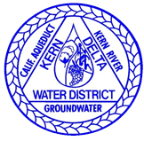
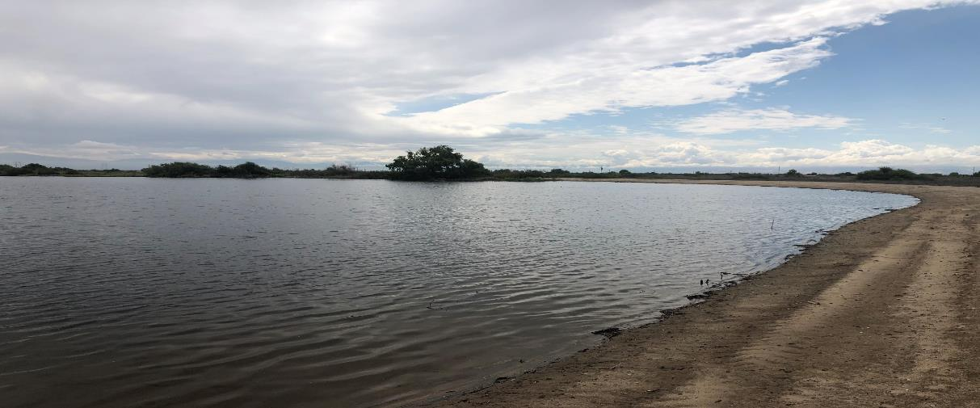
Review Draft
KRGSA Groundwater Sustainability Plan (GSP)
Kern River Groundwater
Sustainability Agency (KRGSA)
Special
Board Meeting
August 21, 2019

Slide 2
KRGSA Sustainability Goal
Manage groundwater resources sustainably in the KRGSA Plan Area to:
    support current and future beneficial uses of groundwater including municipal, agricultural, industrial, domestic, public supply, and environmental uses
    optimize conjunctive use of surface water and groundwater
    avoid or eliminate undesirable results over the implementation and planning horizon.
Notes:
edited

Slide 3
KRGSA GSP Organization
1 Administrative Information
2 Plan Area
3 HCM/Groundwater Conditions
4 Water Budgets
5 Sustainable Management Criteria
6 Monitoring Networks
7 Projects and Management Actions
8 Implementation Plan
9 References and Technical Studies

Slide 4
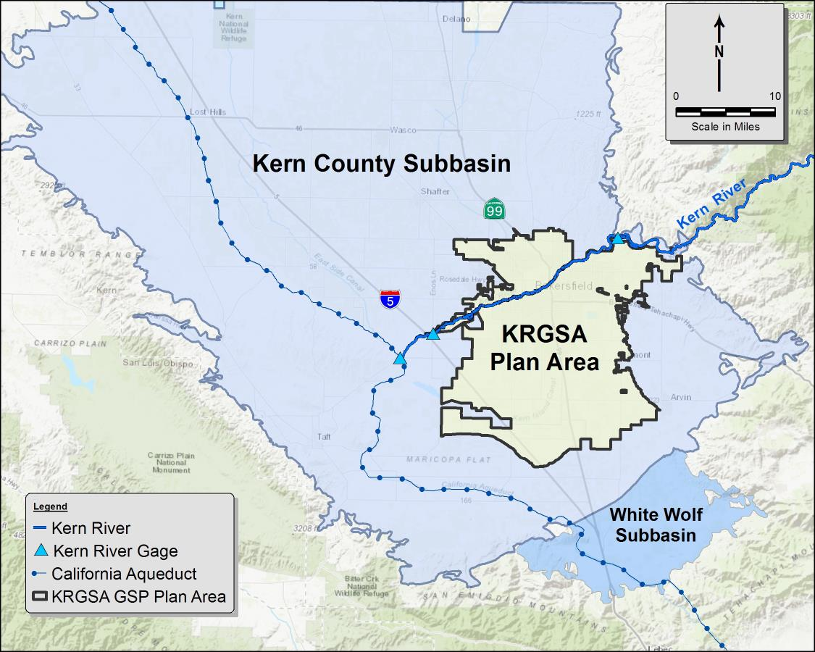
KRGSA GSP Plan Area
361 square miles
13% of the Kern County Subbasin
Composed of:
  City of Bakersfield
  Improvement District No. 4 (KCWA)
  Kern Delta Water District (KDWD)
  Additional smaller agencies
DRAFT

Slide 5
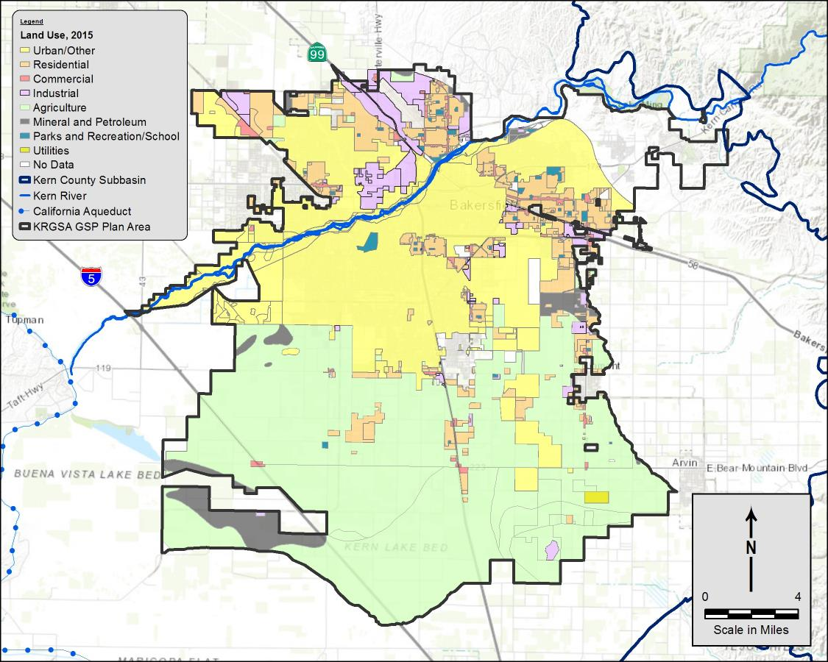
Land Use in the KRGSA Plan Area
7th Standard Rd
North – Urban
South – Agricultural
2015 Land Use
  41% - Agricultural
  33% - Urban
  26% - Undeveloped
DRAFT

Slide 6
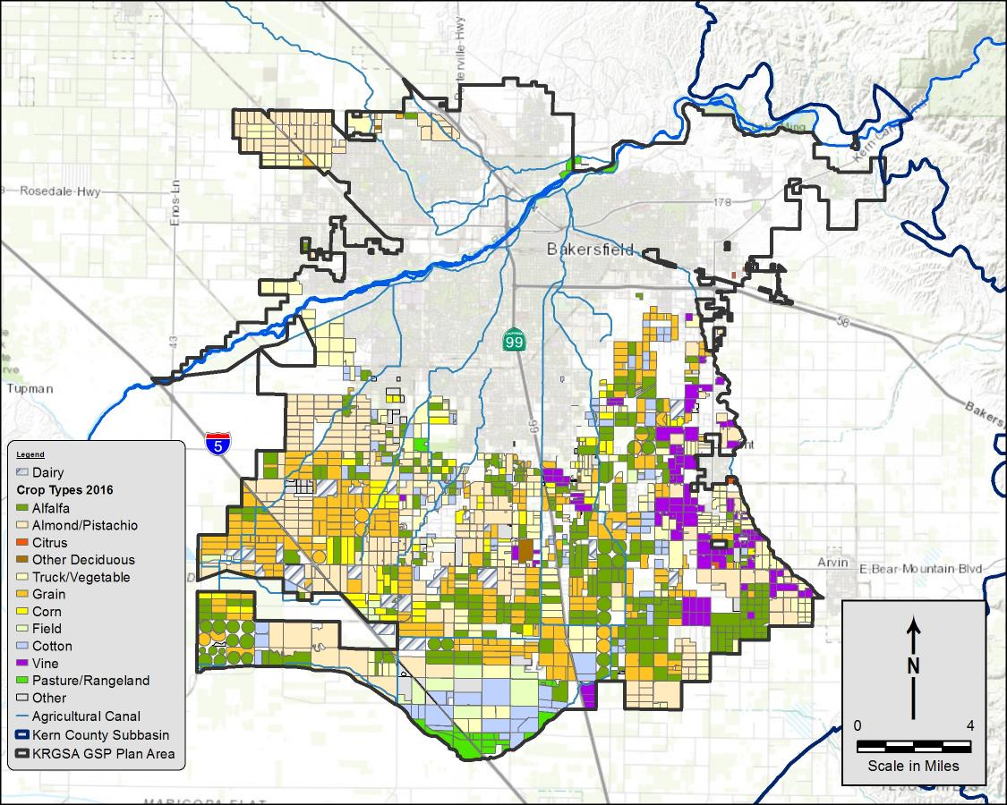
Agricultural Lands in the KRGSA
7th Standard Rd
90,000 acres irrigated agriculture in southern Plan Area
16,000 acres irrigated lands in northern Plan Area
20 Dairies in southern Plan Area
2016 Data
DRAFT

Slide 7
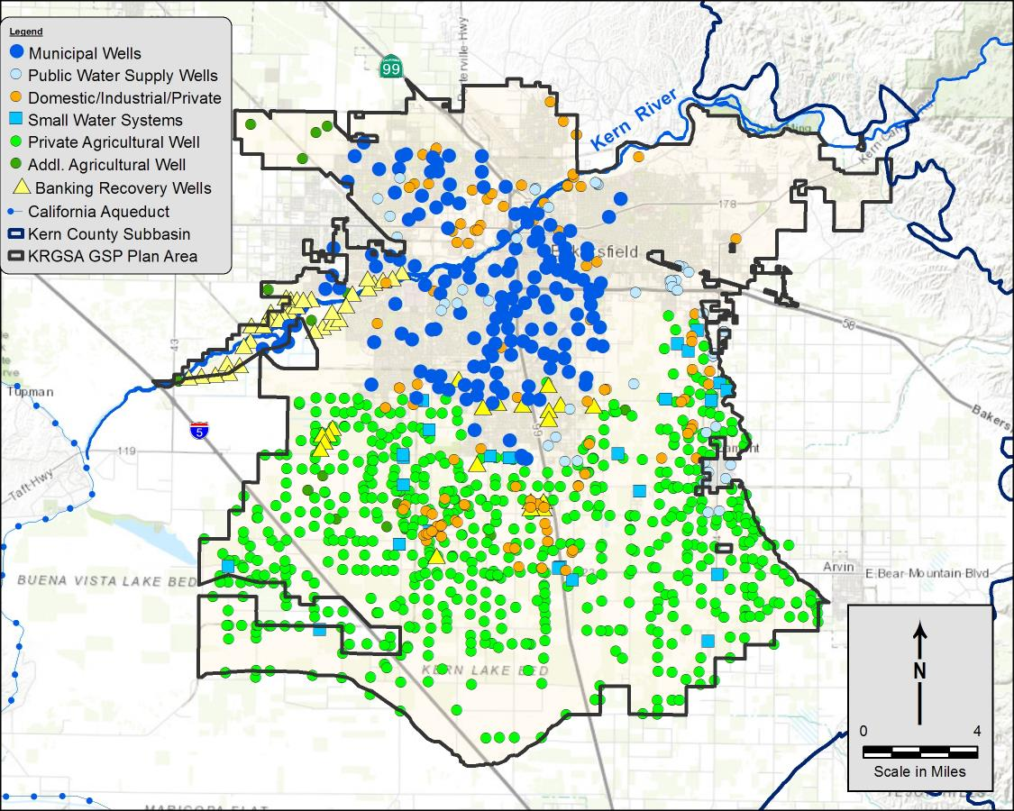
Active Wells in the KRGSA
7th Standard Rd
162 Municipal wells
67 Public Supply and Small Water System wells
151 Industrial, Domestic, and other Private wells
642 Agricultural wells
54 Banking recovery wells
DRAFT

Slide 8
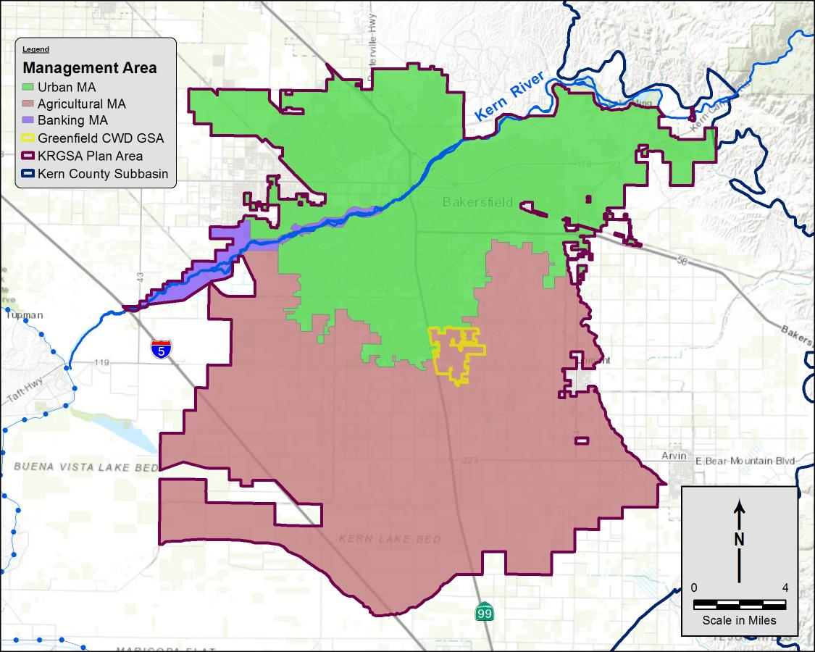
Preliminary Management Areas (MA)
Based on land use and well use
  Urban MA – 41%
  Agricultural MA – 57%
  Banking – 2%
Banking
MA
Urban MA
Agricultural MA
DRAFT

Slide 9





Sustainability Indicators
Chronic Lowering of Water Levels
Reduction of Groundwater Storage
Degradation of Water Quality caused by management actions
Land subsidence affecting land use
Depletion of Interconnected Surface Water affecting beneficial use
If a sustainability indicator is determined to be significant and unreasonable , then it is an Undesirable Result
DRAFT

Slide 10

Chronic Lowering of Water Levels
Undesirable results: when significant and unreasonable impacts occur over the implementation/planning horizon, as determined by depth/elevation of water, affect the reasonable and beneficial use of, and access to, groundwater by overlying users.
Impacts focus on groundwater wells
Balance the need for:
  higher water levels in municipal wells
  lower water levels in irrigation and banking wells, primarily to provide critical supplies during multi-year droughts.
DRAFT

Slide 11
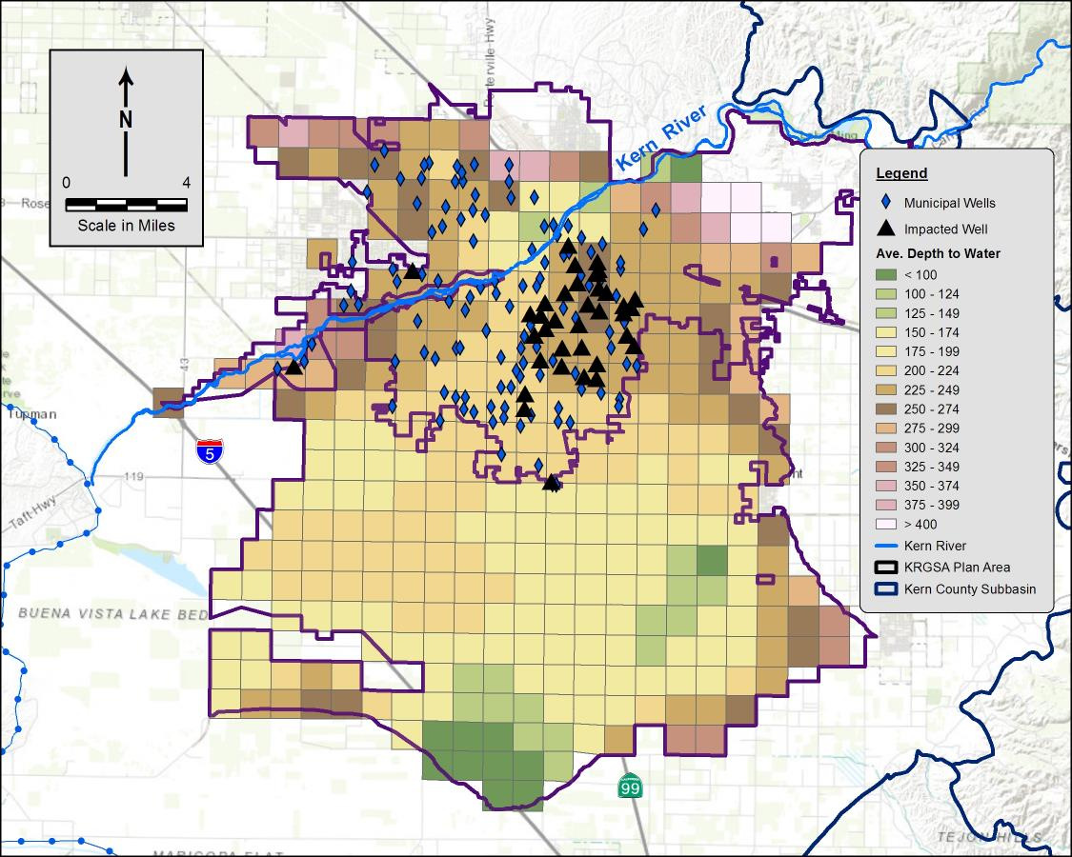
Historic Low WLs Impacts to Wells
7th Standard Rd
Comparison of depth to water and top of municipal well screens
During 2015, water levels were below the top of screens in more than 40 municipal wells
Significant expenditures for lowering pumps, wells offline, securing supplemental supplies
DRAFT

Slide 12
Concentrated pumping in banking and ag wells
7th Standard Rd
More than 150 municipal wells intermingled with more than 50 banking recovery wells
642 Agricultural wells, mostly southern Plan Area
Urban wells extend into the south-central Plan Area
DRAFT

Slide 13

Reduction of Groundwater in Storage
3 Independent Methods
Relatively good agreement
Minimal deficits; sustainable budget
Deficit for banking adjustments

Slide 14
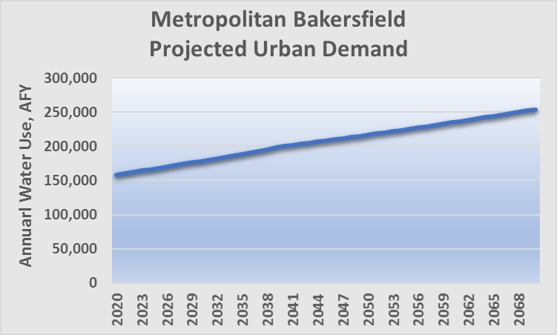
Projected Water Budgets
Future Deficits
Increase urban demand
Decrease SWP supply
Increase agricultural demand (climate changes factors )
Potential Future Water Budget Deficits
Plus Historical Adjusted deficit of -29,000 AFY
DRAFT

Slide 15
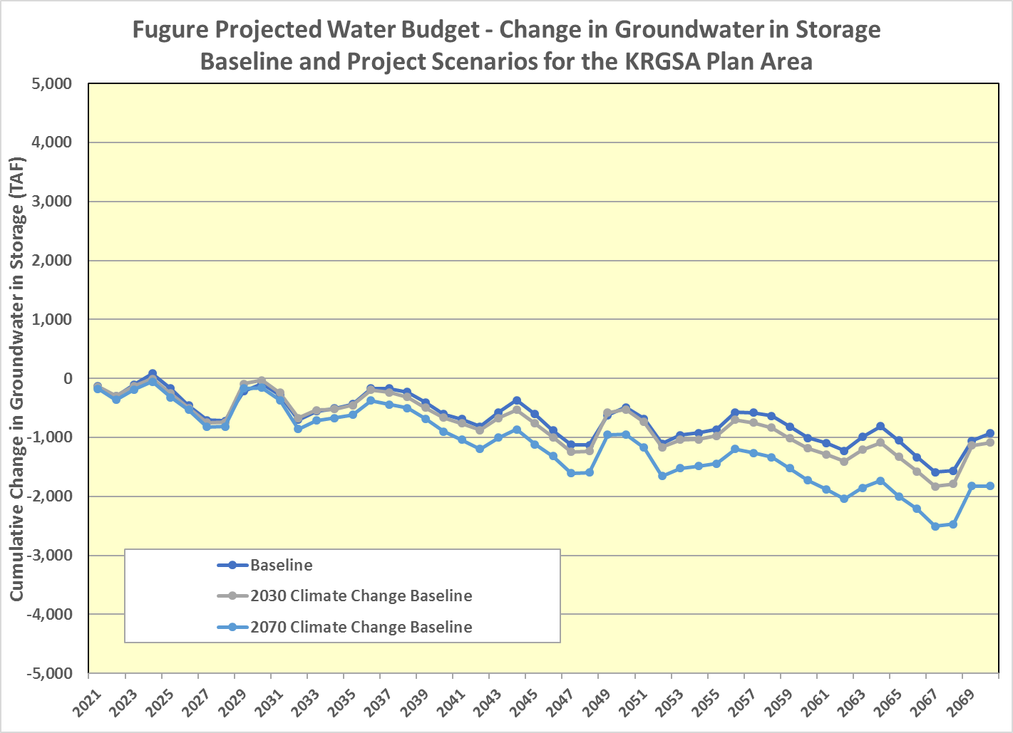
Projected Water Budgets
C2VSimFG-Kern Model
Baseline - current land use and projected water supply and demand
2030 Climate Change Scenario with increases in agricultural demand and decreased supply
2070 Climate Change Scenario with further increase in demand and decrease in supply
Model simulates the physical system and includes recharge in the KRGSA for and by others (i.e, not KRGSA water). KRGSA is planning for larger deficits than indicated in the model.
0
DRAFT

Slide 16
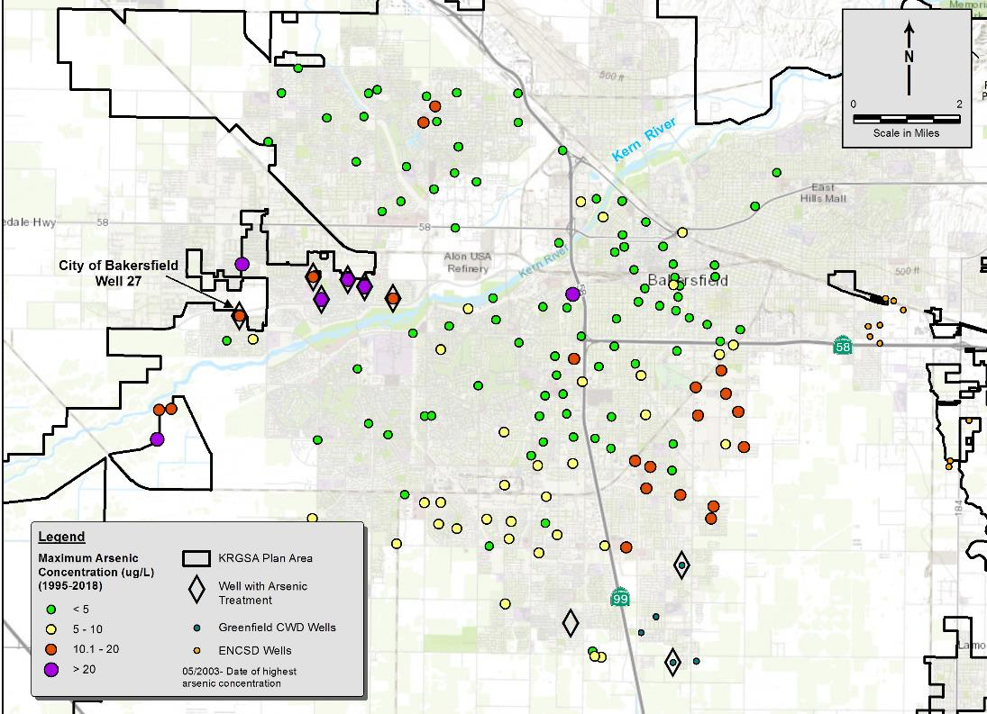
Constituent of Concern Arsenic
7th Standard Rd
Focus on constituents affected by management actions
Arsenic concentrations increase with declining water levels
More than 25 wells with detections above the MCL
Widespread issue in the Plan Area
DRAFT

Slide 17
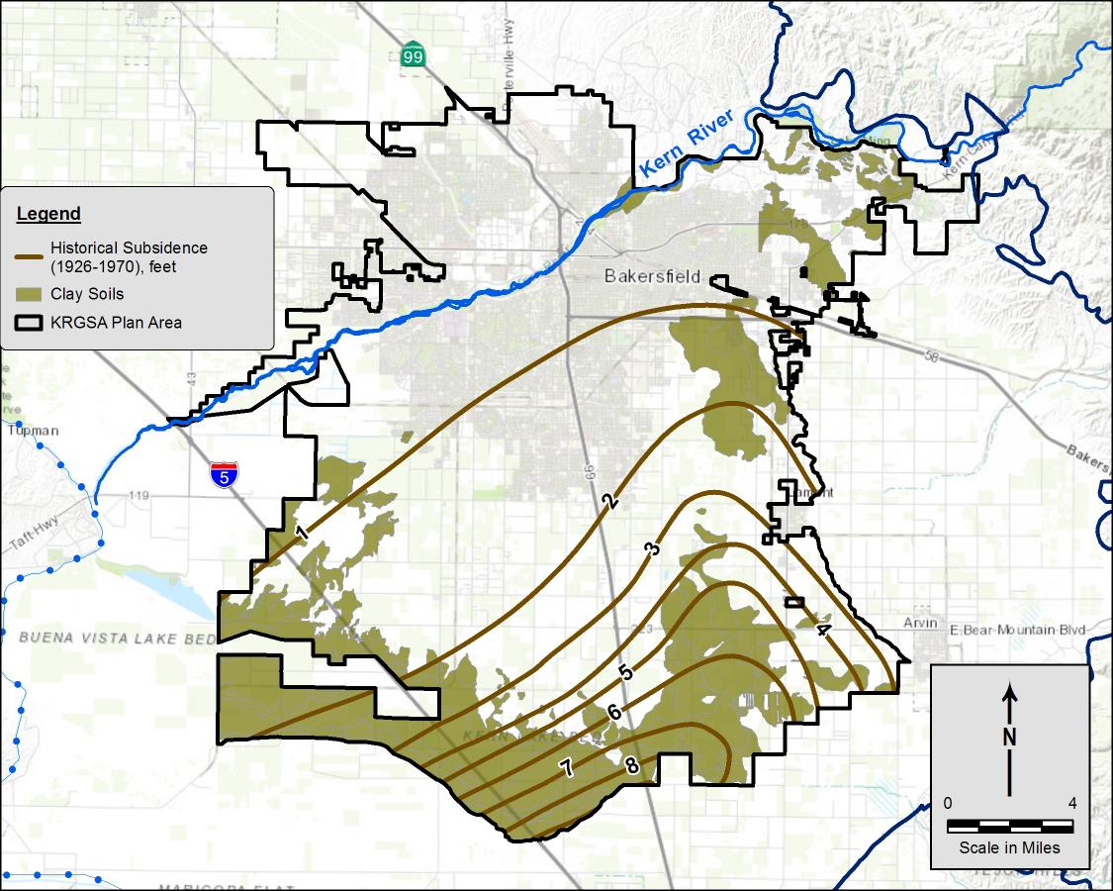
Inelastic Land Subsidence
7th Standard Rd
Historical Subsidence from 1926 – 1970 mapped by USGS
Up to 9 feet in southern Plan Area
Correlates to areas of clay soils (and subsurface clay sediments) in south and east Plan Area
Clay Soils
Clay Soils
Kern Lake Bed
DRAFT

Slide 18
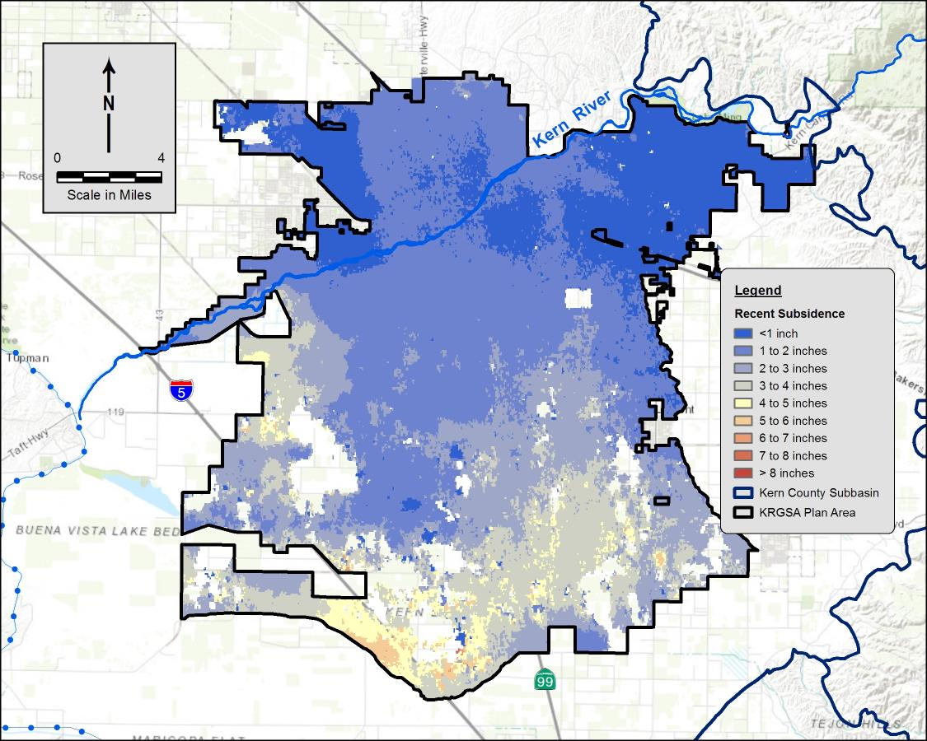
Recent Drought Subsidence
7th Standard Rd
Recent subsidence May 2015 – Dec 2016 from NASA/JPL data
Minimal subsidence in northern Plan Area
-4 to -8 inches in southern Plan Area
Recent subsidence in same areas as historical subsidence
Northern KRGSA <1 inch to 1.5 inches
Central KRGSA -1.5 to -3 inches
Southern KRGSA -4 to -8 inches
NASA/JPL May 2015 – Dec 2016
DRAFT

Slide 19
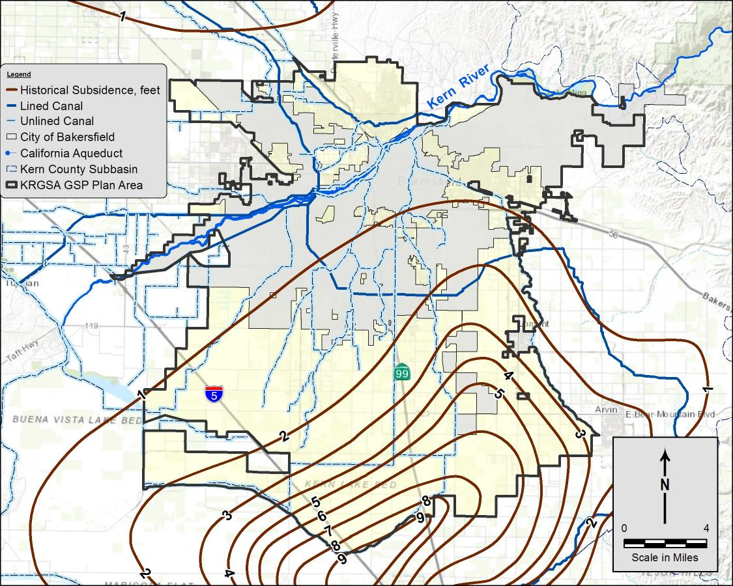
Subsidence and Critical Infrastructure
Critical infrastructure includes pipelines, canals, utilities, structures, wells, transportation
No damage to critical infrastructure in the Plan Area identified to date
Set minimum thresholds to mitigate future subsidence
DRAFT

Slide 20

Analysis of Interconnected Surface Water
Evaluated groundwater conditions using local NCCAG* maps along Kern River
Kern River is actively managed through regulated releases, diversions, and managed aquifer recharge
Kern River
*NCCAG - Natural Communities Commonly
Associated with Groundwater
More than 80% of the flow is diverted above the Calloway Weir
River was dry below the Calloway Weir more than 25 % of the time
Groundwater is deeper than 50’ below the river throughout the entire KRGSA
DRAFT

Slide 21
Analysis of Interconnected Surface Water
Evaluated groundwater conditions at local NCCAG areas in southern Plan Area
Analysis indicates that local vegetation and wetlands are not supported by groundwater in the Principal Aquifer
*NCCAG - Natural Communities Commonly
Associated with Groundwater
Mapped areas include recharge basins, spills along the rim canal, artificially-constructed ski lakes. Local irrigation and perched water conditions throughout the area.
DRAFT

Slide 22
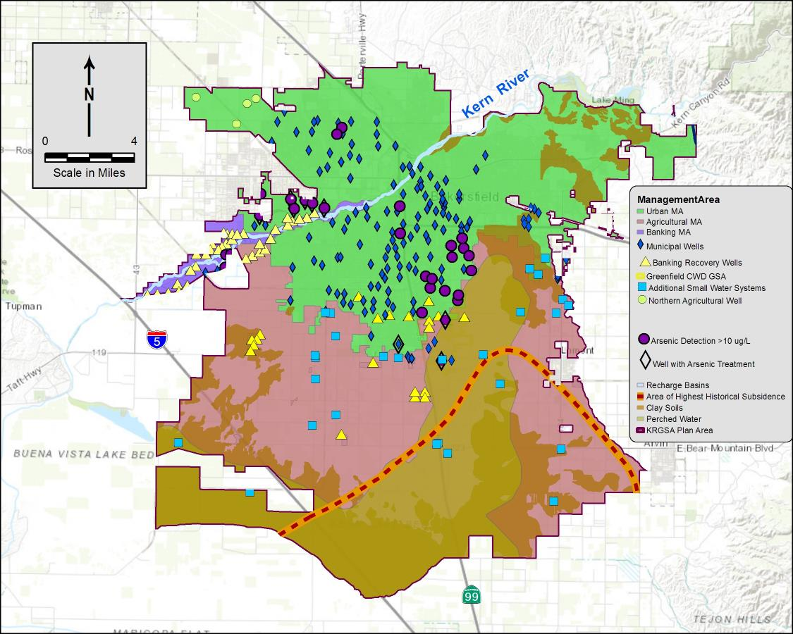




Sustainability Considerations
WL below screens in Municipal Wells
Deficits for Projected Water Budgets
Arsenic in Municipal Wells
Ability of banking recovery wells to recover water
Historical subsidence
DRAFT

Slide 23
Approach to Minimum Thresholds
Undesirable results relate historic low water levels; keep urban wells near historic lows.
Allow operational flexibility for banking wells to recover critical supplies during drought.
Measurable Objectives are selected as the midpoint for an operational range.
Keep MTs and MOs SIMPLE to facilitate management.

Slide 24
Approach to Minimum Thresholds
Add number of wells and duration to refine definition of undesirable results.

Slide 25
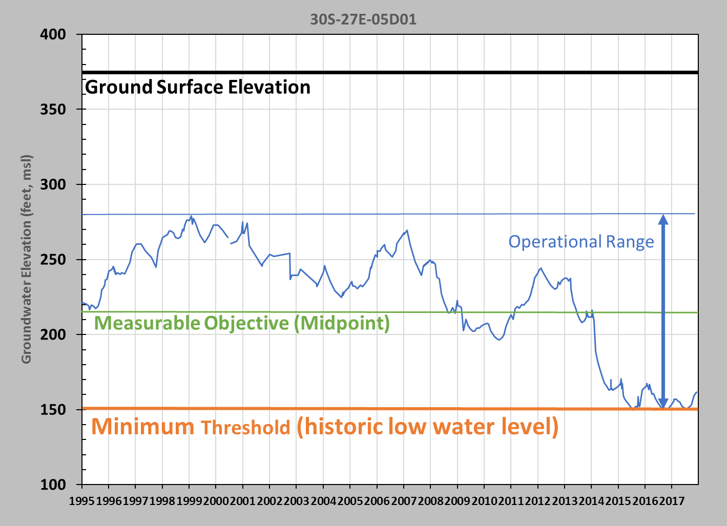
Assignment of MT, MO, and Operational Range

Slide 26

Preliminary GSP Monitoring Wells
36 wells identified
Currently monitored in other WL programs:
  Kern Fan Monitoring Comm
  KCWA/ID4 WL Program
  City Monitoring Wells
  KDWD Monitoring Programs
Possible additional Urban MA wells from Cal Water and ENCSD
DRAFT

Slide 27
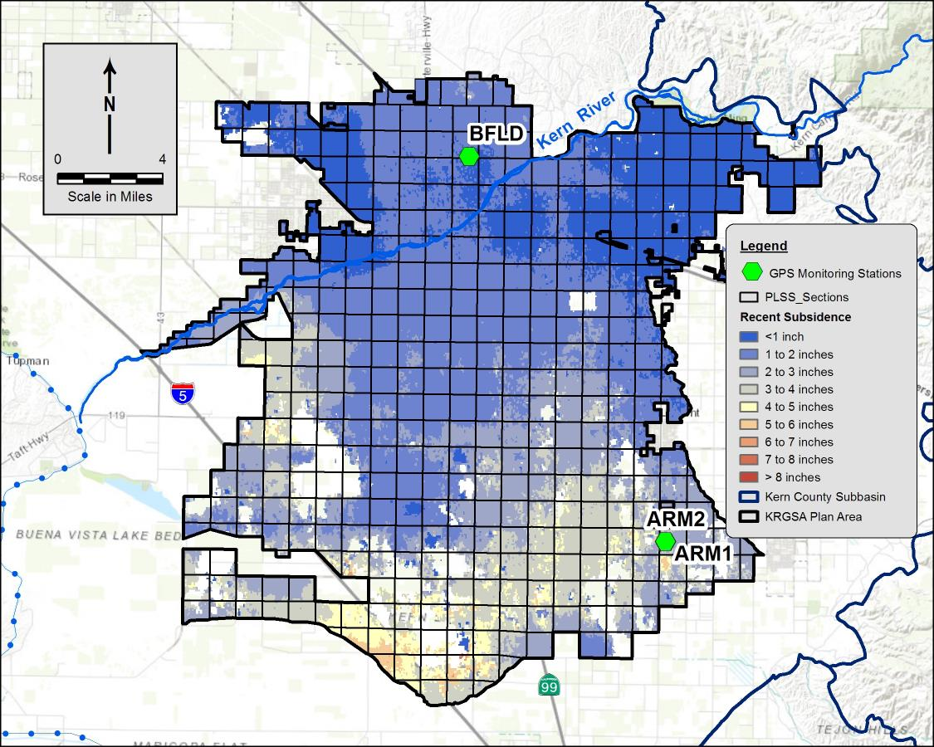
KRGSA Subsidence Monitoring
7th Standard Rd
Water level monitoring
Three GPS stations for screening
InSAR Subsidence available from DWR (on 1-mile grids)
Coordinate with KGA and other GSAs for regional Subbasin-wide subsidence monitoring
NASA/JPL May 2015 – Dec 2016
DRAFT

Slide 28
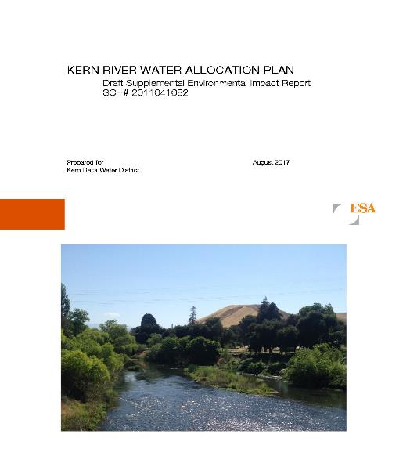
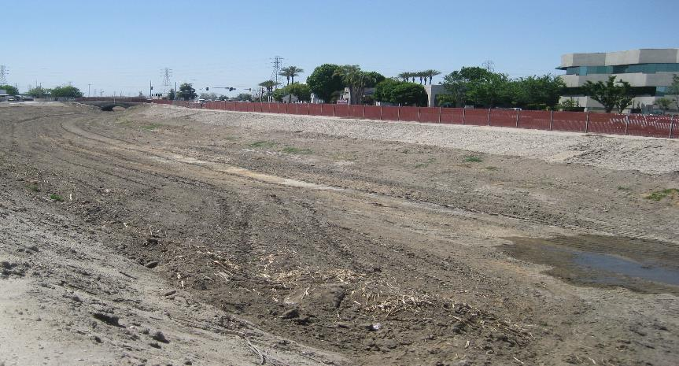
Key Management Projects
KDWD Kern River Water Allocation Plan
  Optimizes Kern River recharge across the southern Plan Area
  Reduces groundwater pumping
  Allows local maintenance of water levels
  SEIR completed 2018 – implementation initiated
DRAFT

Slide 29
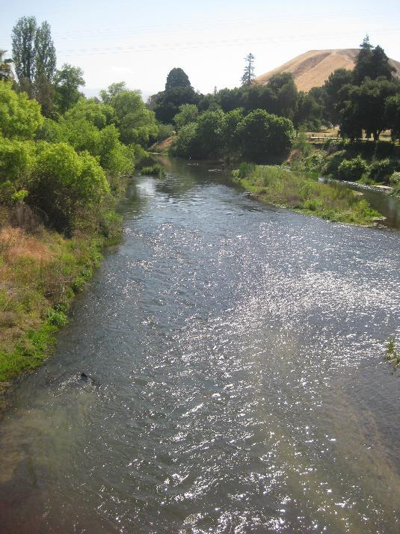
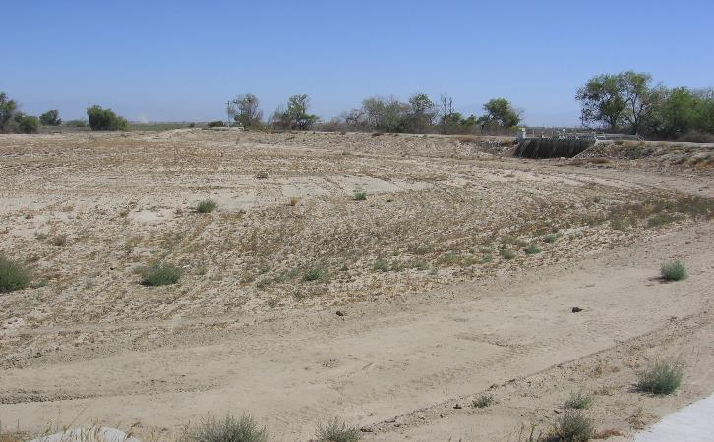
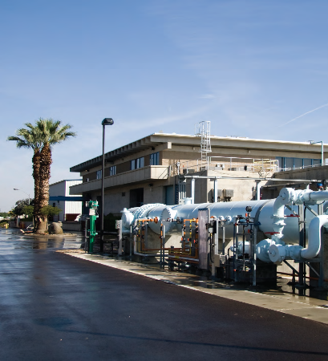
Key Management Projects
City of Bakersfield Optimized Conjunctive Use
  Prioritizes use of City’s available Kern River water
  Increasing water availability over the implementation and planning horizon
  Allows municipal pumping to be reduced to avoid undesirable results
  Meets future projected water budget deficits for urban demand
DRAFT

Slide 30
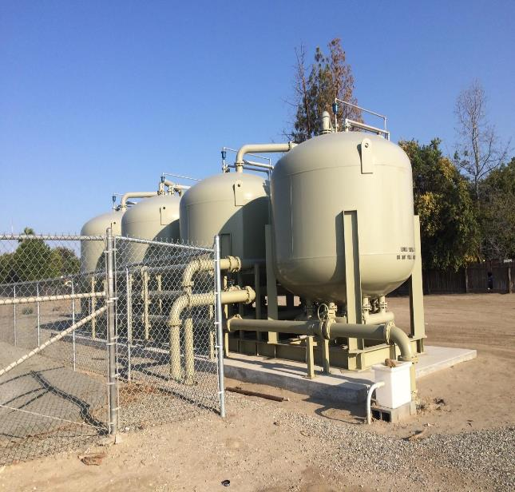
Key Management Projects
East Niles Community Services District
North Weedpatch Highway Consolidation
Consolidation of up to six small water systems with ENCSD to address water quality concerns: nitrate, TCP, and arsenic
Grant funding through the DWRSF program
Improves drinking water quality for disadvantaged communities in the KRGSA
1,2,3-TCP Wellhead Treatment
DRAFT

Slide 31
Management Actions
5-Step Action Plan if Minimum Thresholds are exceeded
Implement well metering in the Agricultural MA (KDWD)
Program for reporting groundwater extractions in the KRGSA
Conserve recycled water in the KRGSA Plan Area (City)
Support Delta Conveyance to preserve imported supplies
Incorporate Climate Change Adaptation Stratgies (ID4)
Improve monitoring program
Coordinate water quality analysis with existing programs
DRAFT

Slide 32
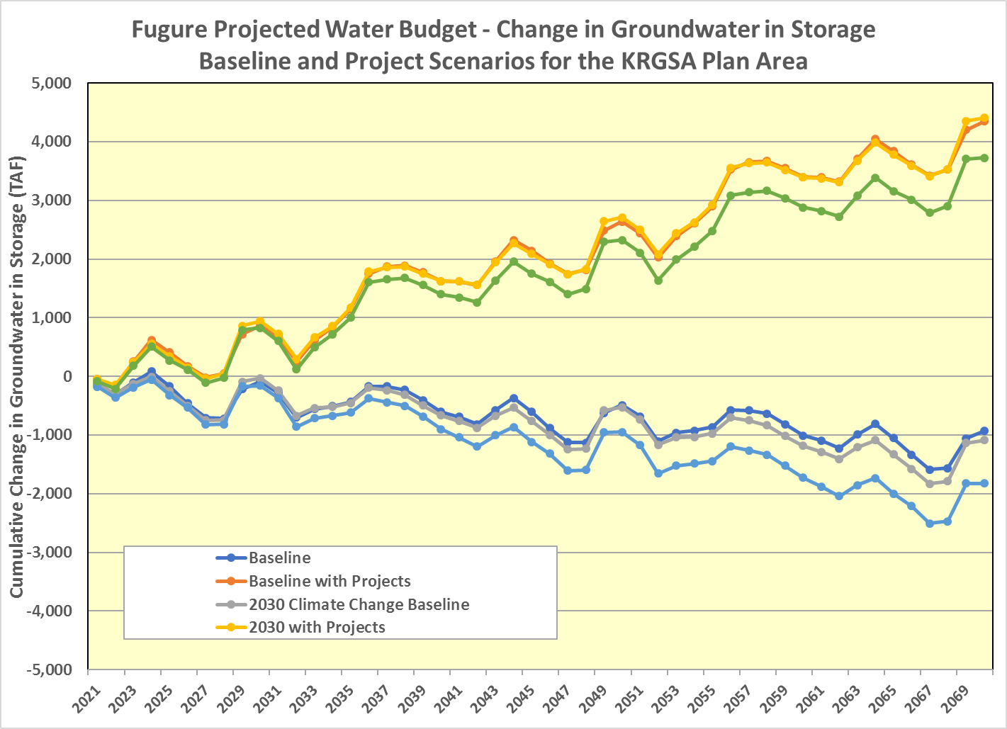
Projected Water Budgets with Projects
Collectively, these projects and management actions address current and projected groundwater deficits to achieve sustainable management.
0
DRAFT

Slide 33
90-Review Period and Outreach
Communication and outreach with Stakeholders for GSP input
Outreach accomplished at many levels:
  Agency Board Meetings and Workshops
  Targeted community meetings
  Coordinate with other GSAs on Open House
GSP is a draft document and can be revised based on input:
  Working to improve monitoring program
  Incorporate details on how GSP implementation can be achieved
KRGSA supports collaborative efforts and internal coordination to achieve sustainable management for the Subbasin shared groundwater resources
DRAFT

Slide 34
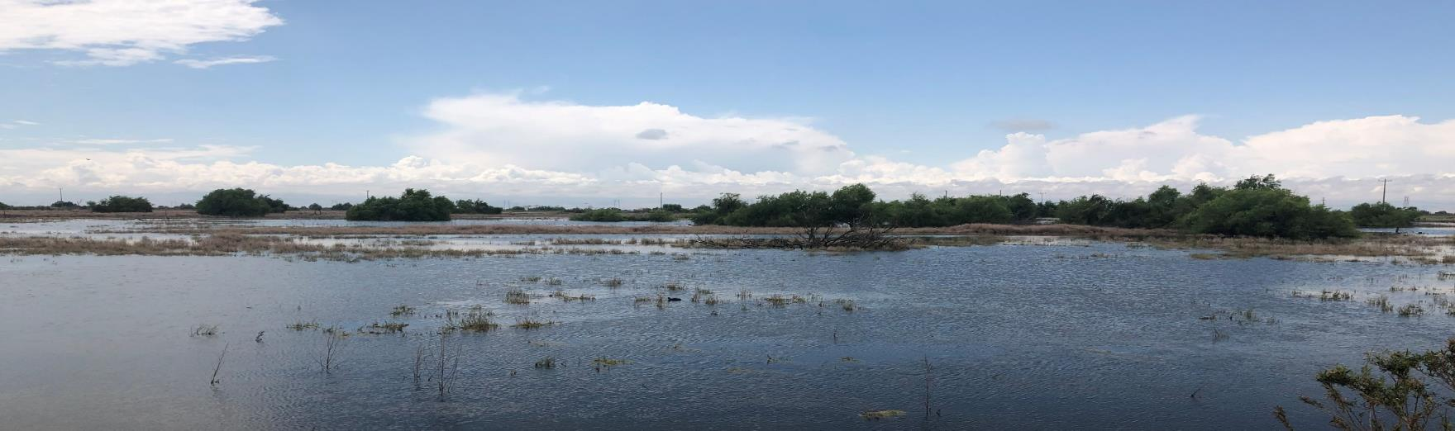
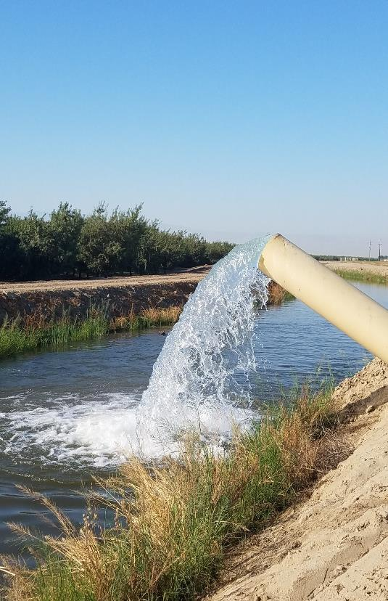
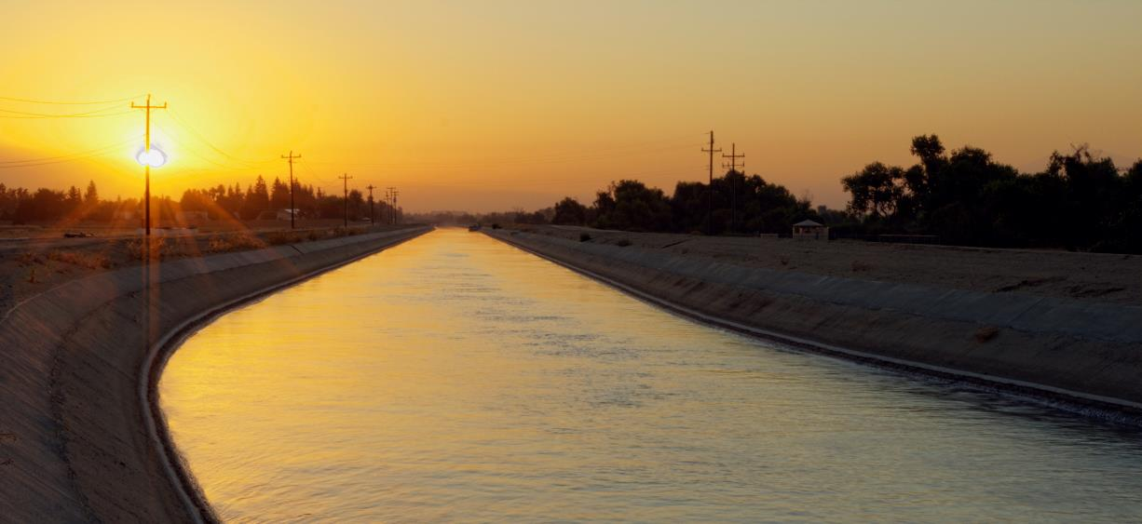
Questions?

