Slide 1
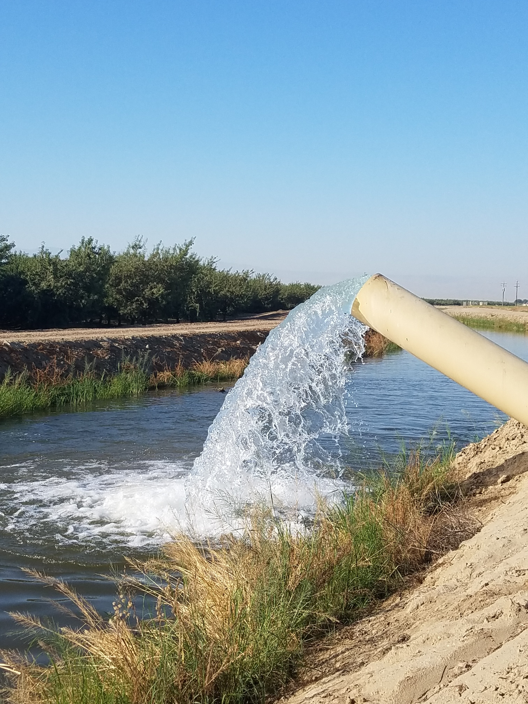


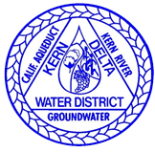
KRGSA Groundwater
Sustainability Plan (GSP)
Final Draft
Kern River Groundwater
Sustainability Agency (KRGSA)
Public Hearing
KRGSA Board Meeting
December 5, 2019

Slide 2
KRGSA Sustainability Goal
Manage groundwater resources sustainably in the KRGSA Plan Area to:
    support current and future beneficial uses of groundwater including municipal, agricultural, industrial, domestic, public supply, and environmental uses
    optimize conjunctive use of surface water and groundwater
    avoid or eliminate undesirable results over the implementation and planning horizon.
DRAFT
Notes:
edited

Slide 3
KRGSA GSP Organization
1 Administrative Information
2 Plan Area
3 HCM/Groundwater Conditions
4 Water Budgets
5 Sustainable Management Criteria
6 Monitoring Networks
7 Projects and Management Actions
8 Implementation Plan
9 References and Technical Studies
DRAFT

Slide 4
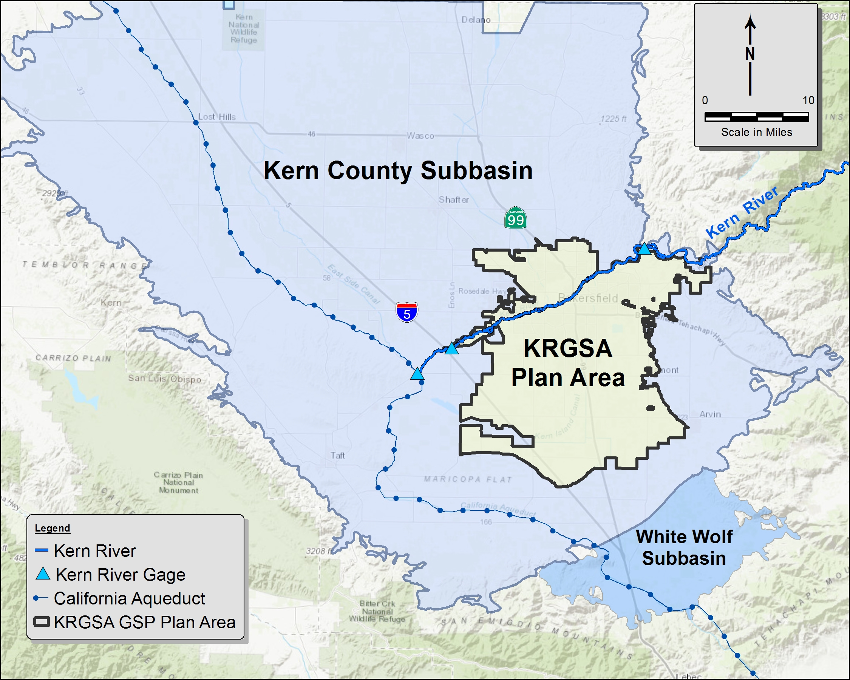
KRGSA GSP Plan Area
361 square miles
13% of the Kern County Subbasin
Composed of:
  City of Bakersfield
  Improvement District No. 4 (KCWA)
  Kern Delta Water District (KDWD)
  Additional smaller agencies
DRAFT

Slide 5
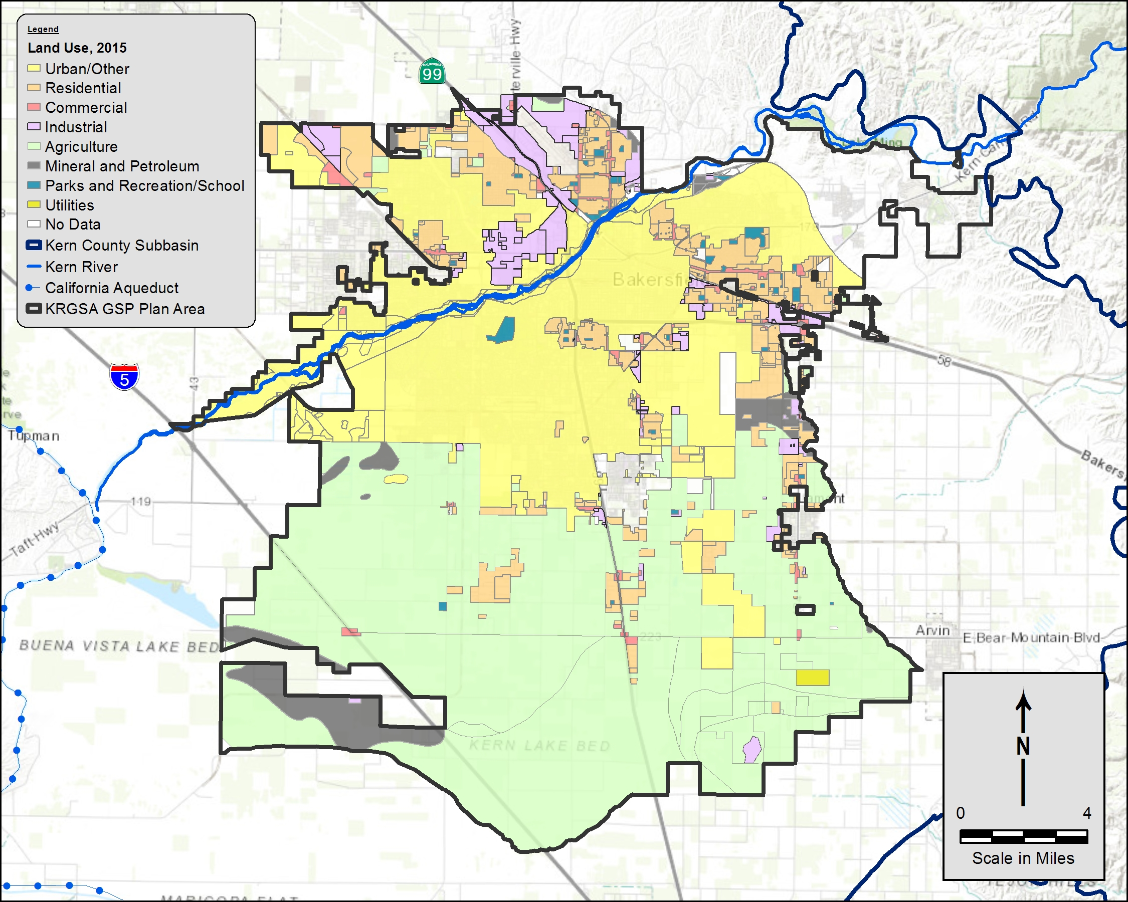
Land Use in the KRGSA Plan Area
7th Standard Rd
North – Urban
South – Agricultural
2015 Land Use
  41% - Agricultural
  33% - Urban
  26% - Undeveloped
DRAFT

Slide 6
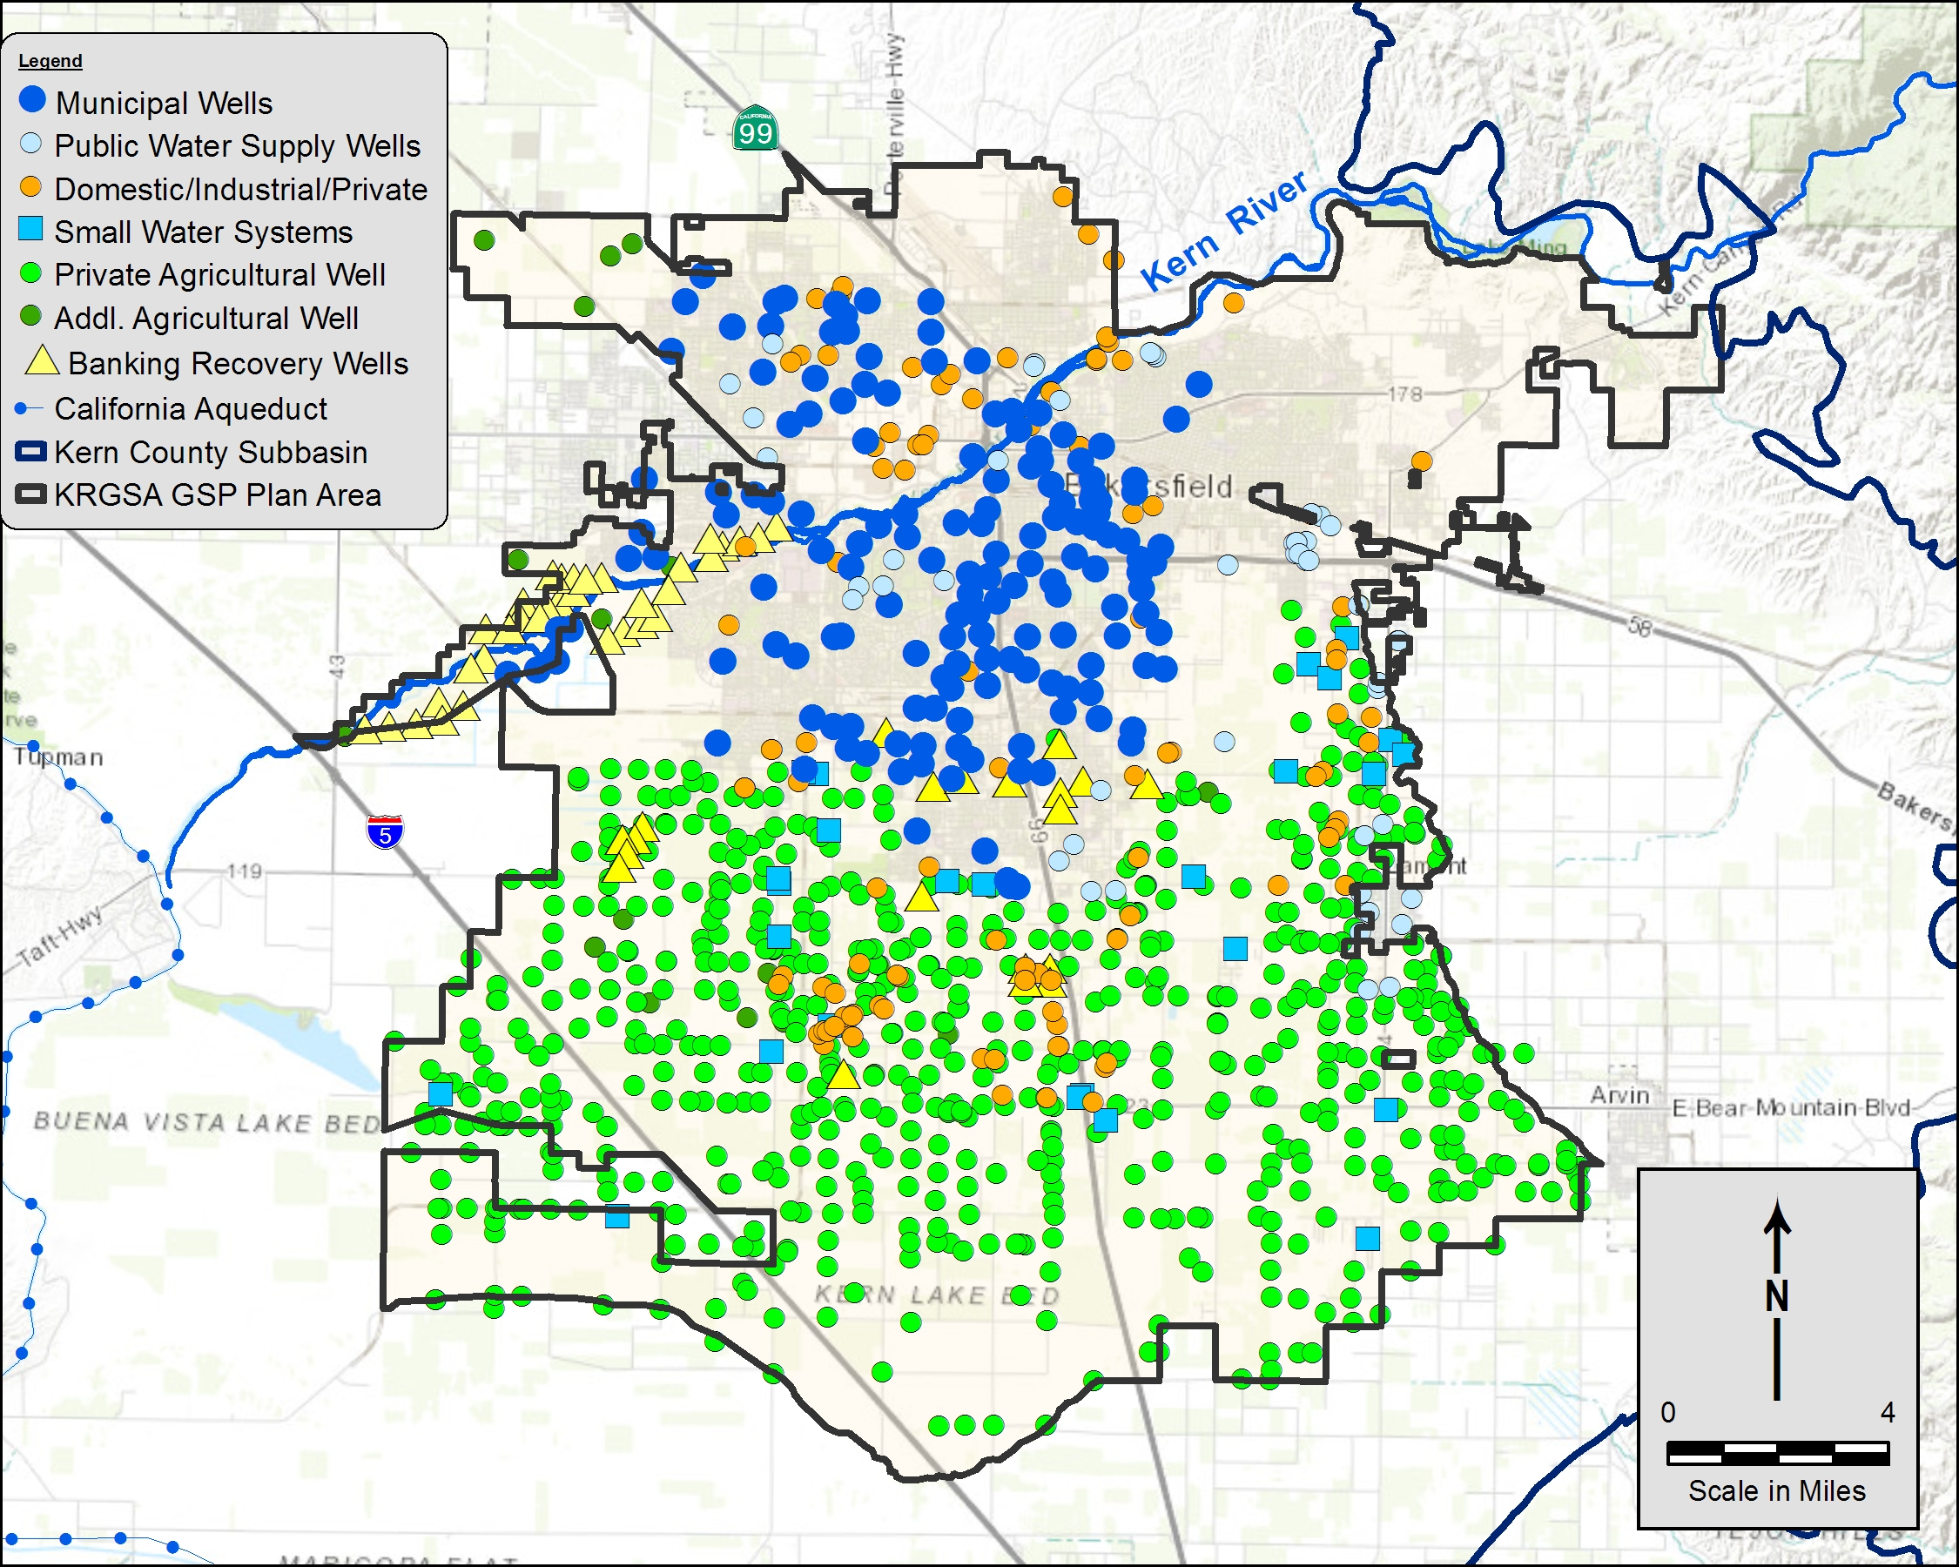
Active Wells in the KRGSA
7th Standard Rd
162 Municipal wells
67 Public Supply and Small Water System wells
151 Industrial, Domestic, and other Private wells
642 Agricultural wells
54 Banking recovery wells
DRAFT
Notes:
More than 1,000 active wells in the KRGSA

Slide 7
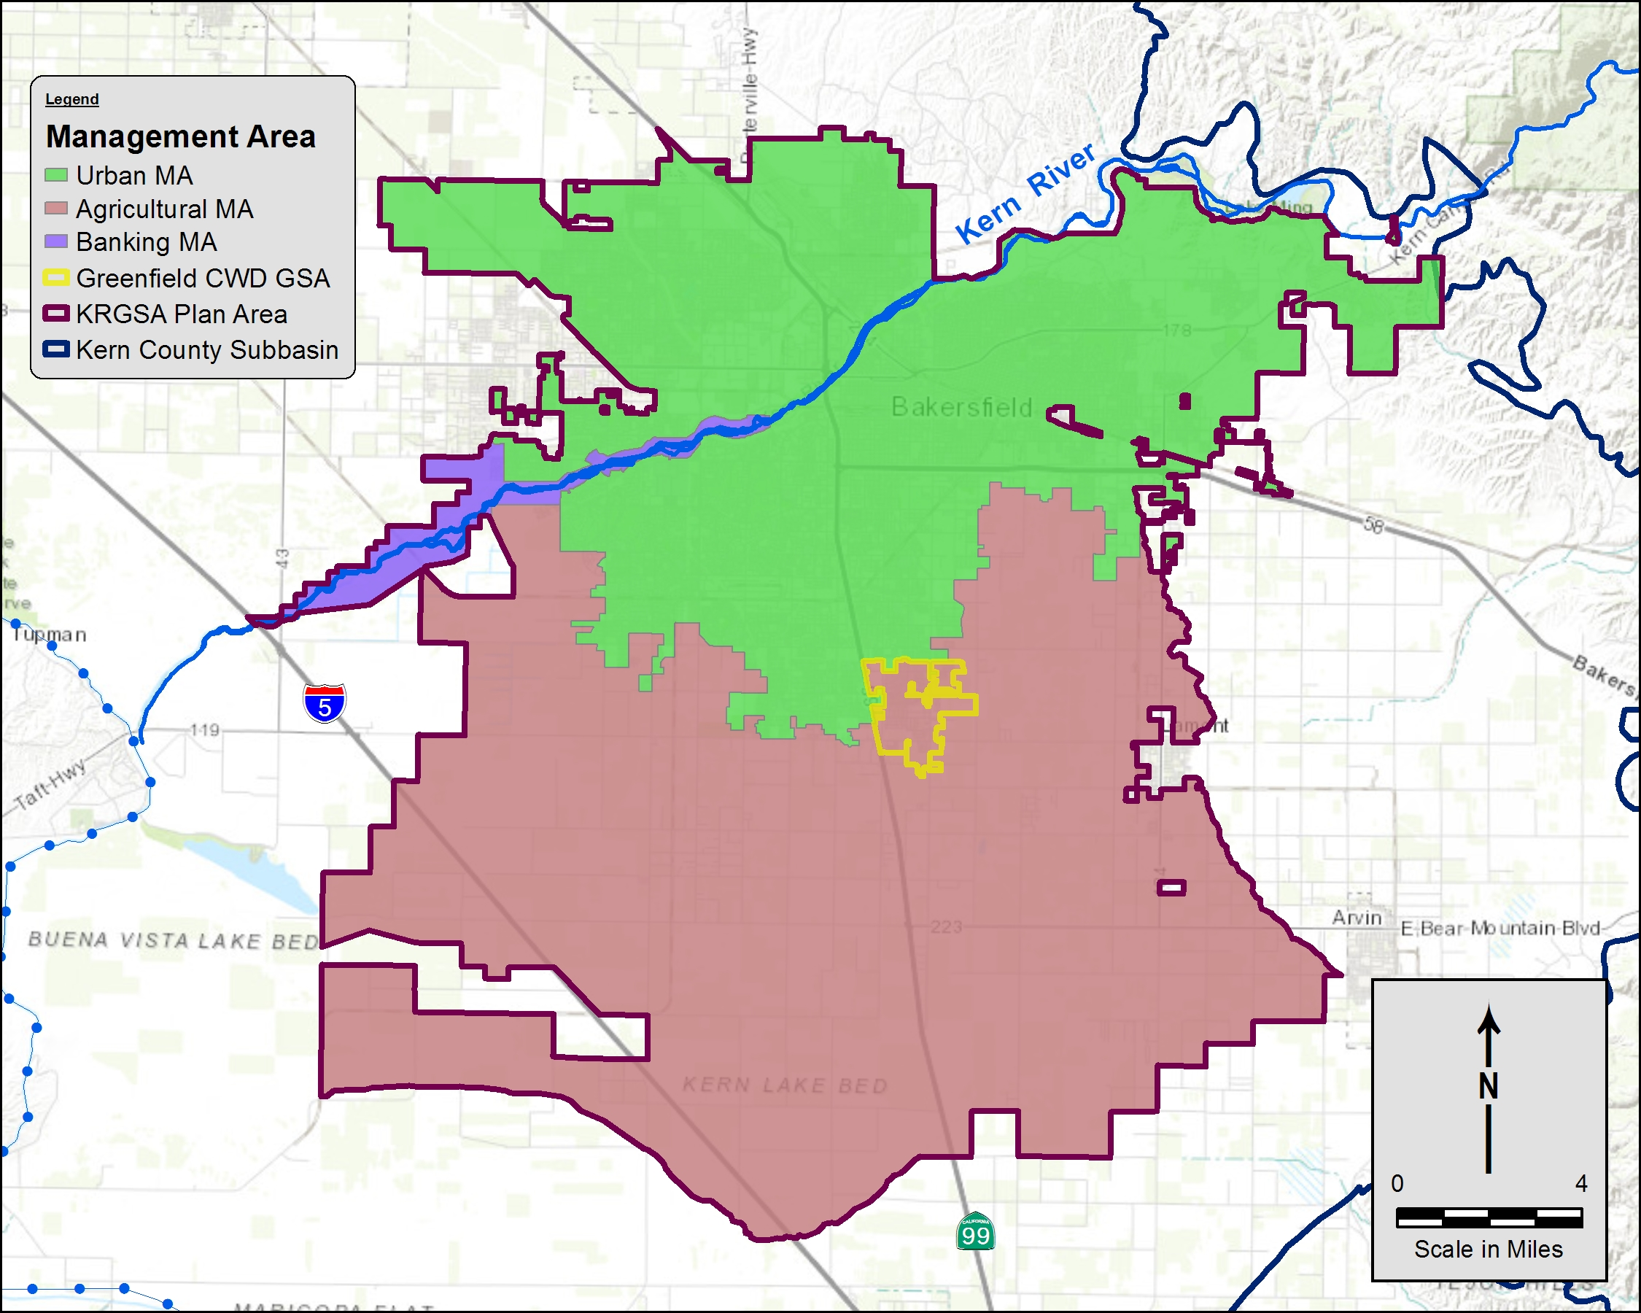
Preliminary Management Areas (MA)
Banking
MA
Based on land use and well use
  Urban MA – 41%
  Agricultural MA – 57%
  Banking – 2%
Urban MA
Agricultural MA
DRAFT

Slide 8





Sustainability Indicators
Chronic Lowering of Water Levels
Reduction of Groundwater Storage
Degradation of Water Quality caused by management actions
Land subsidence affecting land use
Depletion of Interconnected Surface Water affecting beneficial use
If a sustainability indicator is determined to be significant and unreasonable , then it is an Undesirable Result
DRAFT

Slide 9
Balance High and Low WLs
7th Standard Rd
Municipal wells went dry or experienced problems during drought – keep water levels above historic lows
Agricultural and banking wells require lower water levels
Balance needs of KRGSA wells
DRAFT

Slide 10
Reduction of Groundwater in Storage
3 Independent Methods
Relatively good agreement
Minimal deficits; sustainable budget
Deficit for banking adjustments

Slide 11
Projected Water Budgets
Future Deficits
Increase urban demand
Decrease SWP supply
Increase agricultural demand (climate changes factors )
Potential Future Water Budget Deficits
Plus Historical Adjusted deficit of -29,000 AFY
DRAFT

Slide 12
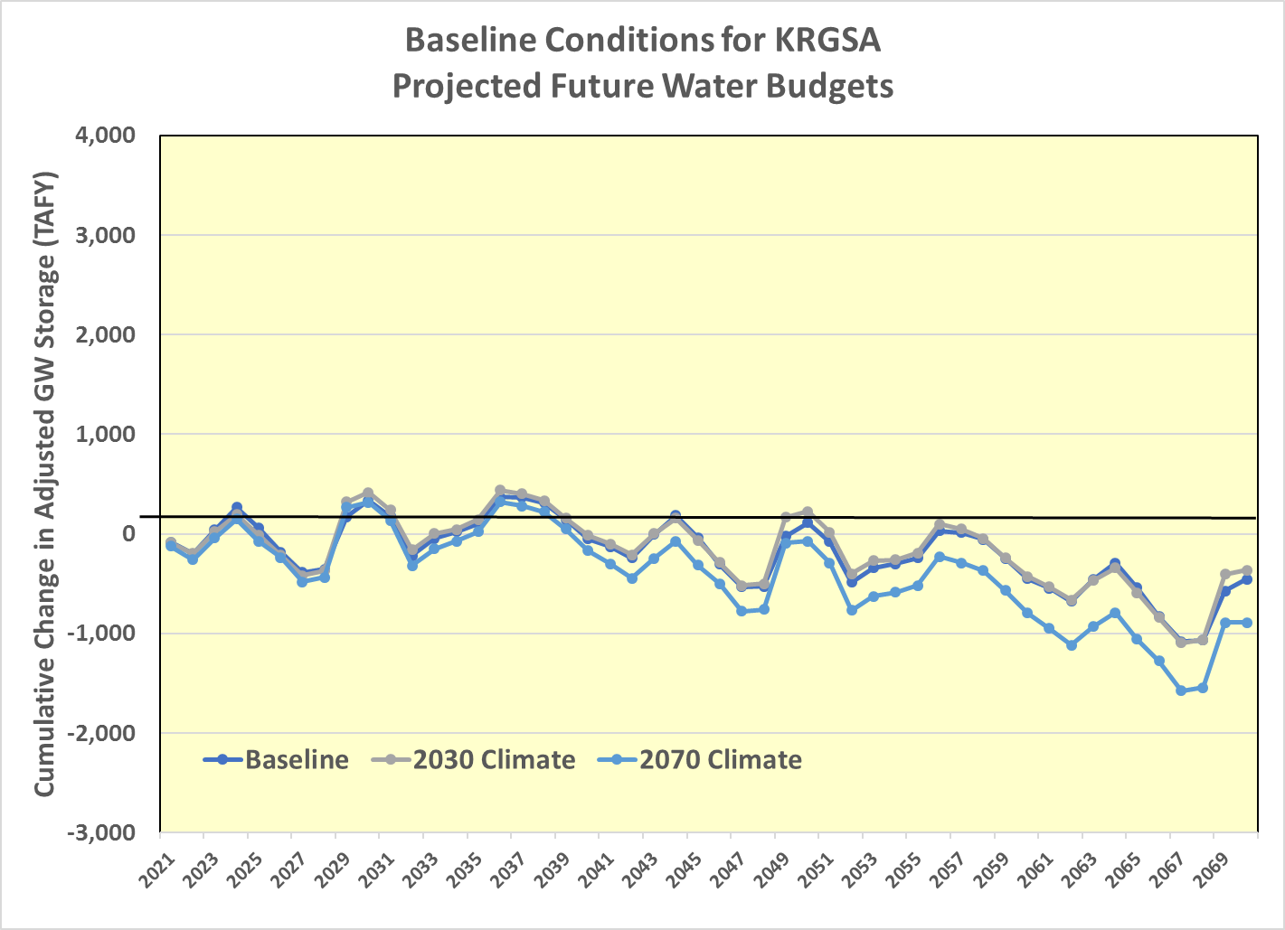
Projected Water Budgets
C2VSimFG-Kern Model
Baseline - current land use and projected water supply and demand
2030 Climate Change Scenario with increases in agricultural demand and decreased supply
2070 Climate Change Scenario with further increase in demand and decrease in supply
Model simulates the physical system and includes recharge in the KRGSA for and by others;
KRGSA is planning for larger deficits than indicated in the model.
DRAFT

Slide 13
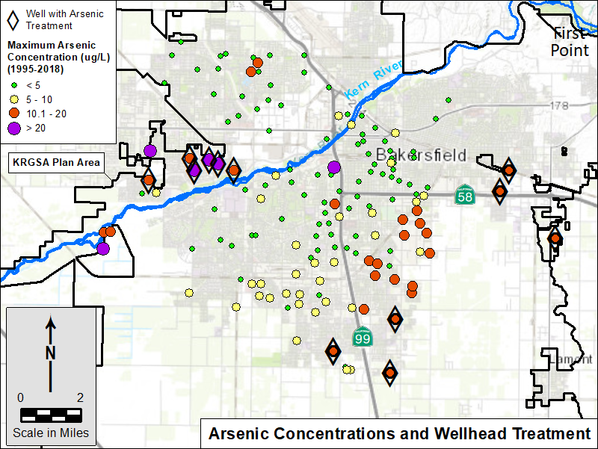
Constituent of Concern Arsenic
7th Standard Rd
Focus on constituents affected by management actions
Arsenic concentrations increase with declining water levels
More than 25 wells with detections above the MCL
Widespread issue in the Plan Area
DRAFT

Slide 14
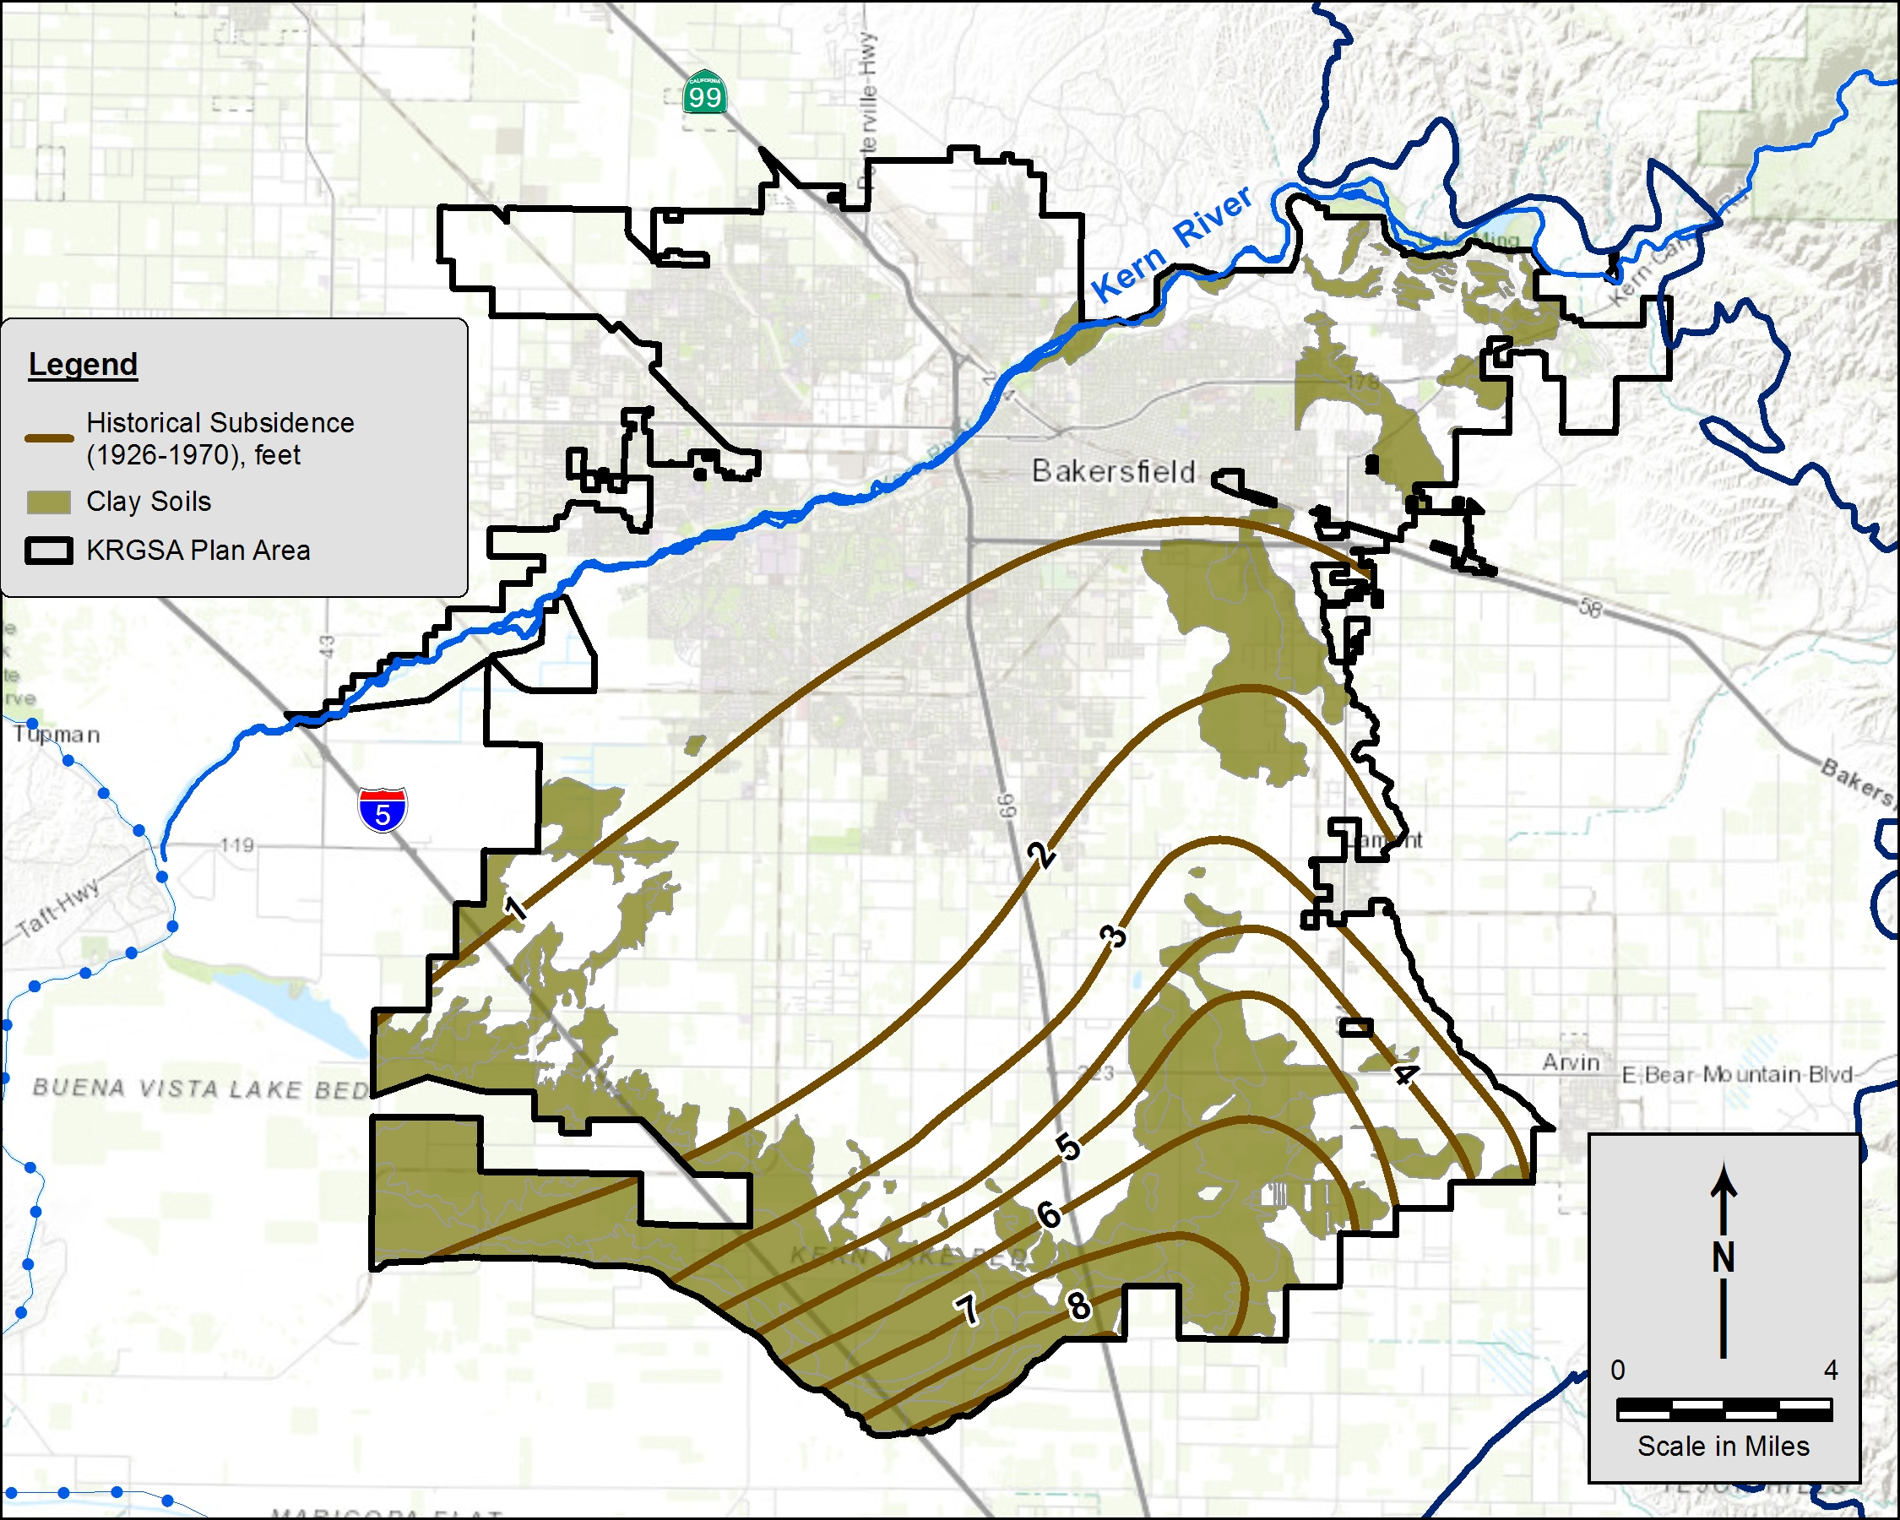
Inelastic Land Subsidence
7th Standard Rd
Historical Subsidence from 1926 – 1970 mapped by USGS
Up to 9 feet in southern Plan Area
Correlates to areas of clay soils and subsurface clay sediments in southeast Plan Area
Clay Soils
Clay Soils
Kern Lake Bed
DRAFT

Slide 15
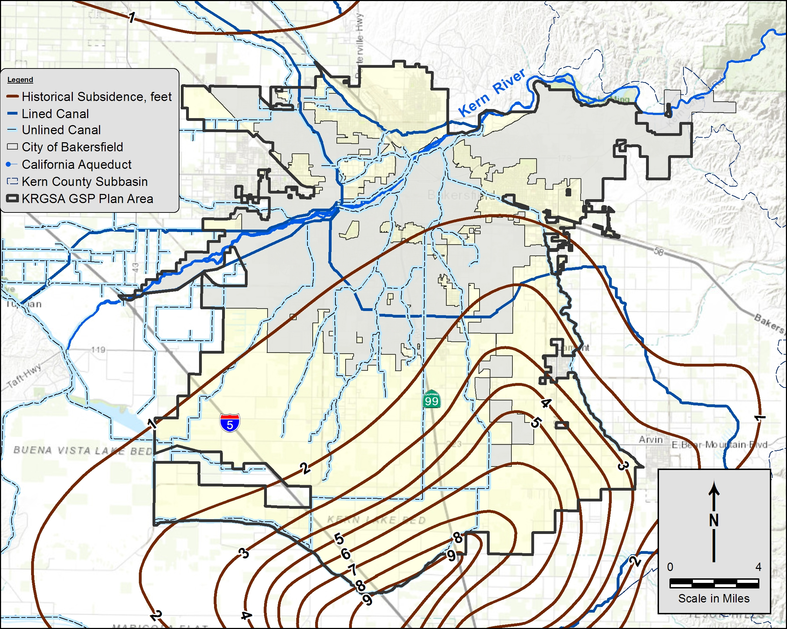
Subsidence and Critical Infrastructure
Critical infrastructure includes pipelines, canals, utilities, structures, wells, transportation
No damage to critical infrastructure in the Plan Area identified to date
Set minimum thresholds to mitigate future subsidence
DRAFT

Slide 16
Analysis of Interconnected Surface Water
Evaluated groundwater conditions using local NCCAG* maps along Kern River
Kern River is actively managed through regulated releases, diversions, and managed aquifer recharge
Kern River
*NCCAG - Natural Communities Commonly
Associated with Groundwater
More than 80% of the flow is diverted above the Calloway Weir
River was dry below the Calloway Weir more than 25 % of the time
Groundwater is deeper than 50’ below the river throughout the entire KRGSA
DRAFT

Slide 17
Analysis of Interconnected Surface Water
Evaluated groundwater conditions at local NCCAG areas in southern Plan Area
Analysis indicates that local vegetation and wetlands are not supported by groundwater in the Principal Aquifer
*NCCAG - Natural Communities Commonly
Associated with Groundwater
Mapped areas include recharge basins, spills along the rim canal, artificially-constructed ski lakes. Local irrigation and perched water conditions throughout the area.
DRAFT

Slide 18
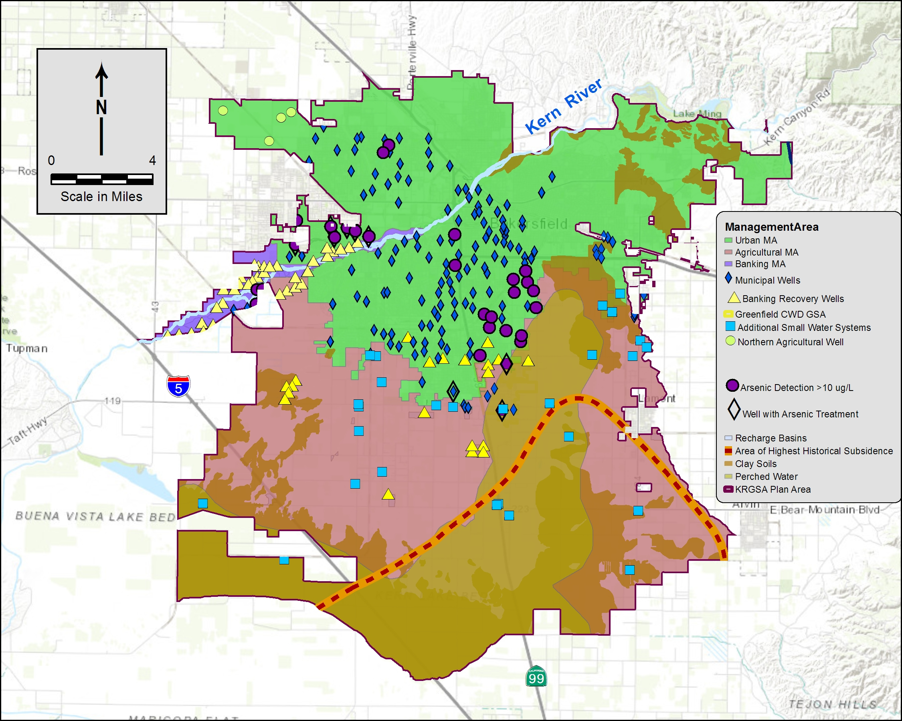
Sustainability Considerations
WL below screens in Municipal Wells
Ability of banking recovery wells to recover water
Arsenic in Municipal Wells
Deficits for Projected Water Budgets
Historical subsidence
DRAFT

Slide 19
Approach to Minimum Thresholds
DRAFT
Undesirable results relate historic low water levels; keep urban wells near historic lows.
Allow operational flexibility for banking wells to recover critical supplies during drought.
Measurable Objectives are selected as the midpoint for an operational range.
Keep MTs and MOs SIMPLE to facilitate management.

Slide 20
Approach to Undesirable Results
Add number of wells and duration to refine definition of undesirable results.
DRAFT

Slide 21
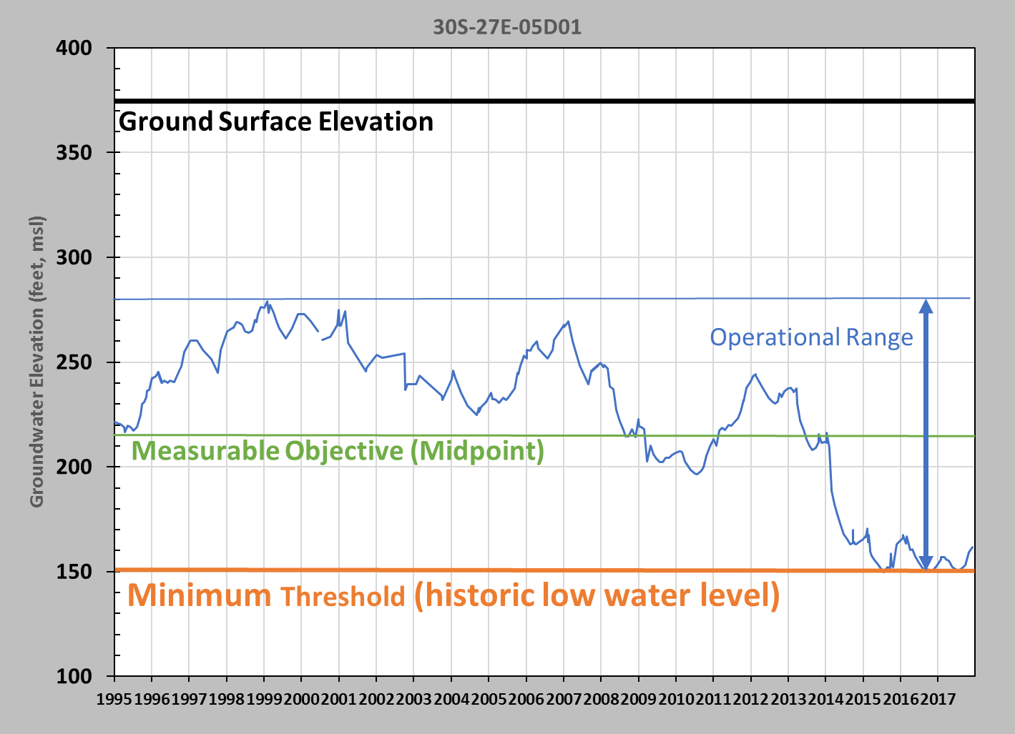
Assignment of Minimum Thresholds (MTs) and Measurable Objectives (MOs)
Example hydrograph from monitoring well
In Urban MA, MT is set at the historic low water level
The MO is the average between the high level and the MT
DRAFT

Slide 22
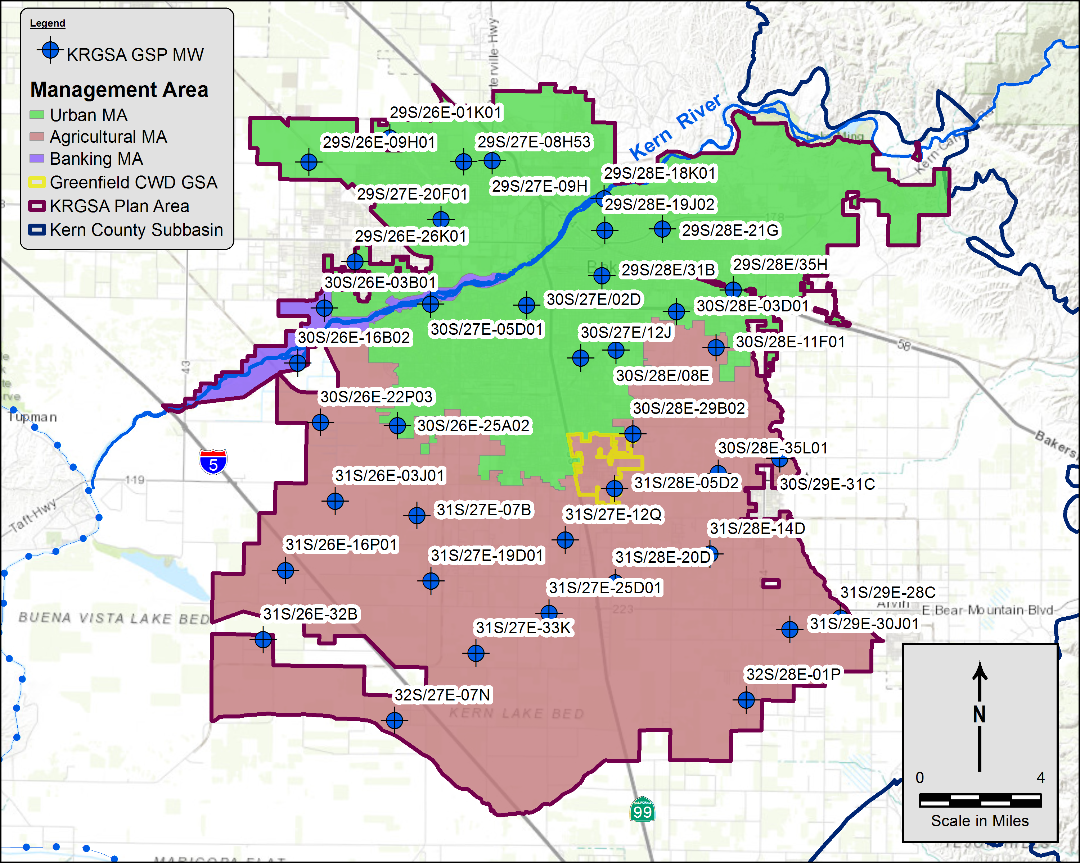
Improved GSP Monitoring Network
39 wells identified
Improved well selection
Added inactive wells to replace production wells
Water level monitoring only
Best use of other WL programs
Incorporates water quality data from numerous existing programs
DRAFT

Slide 23
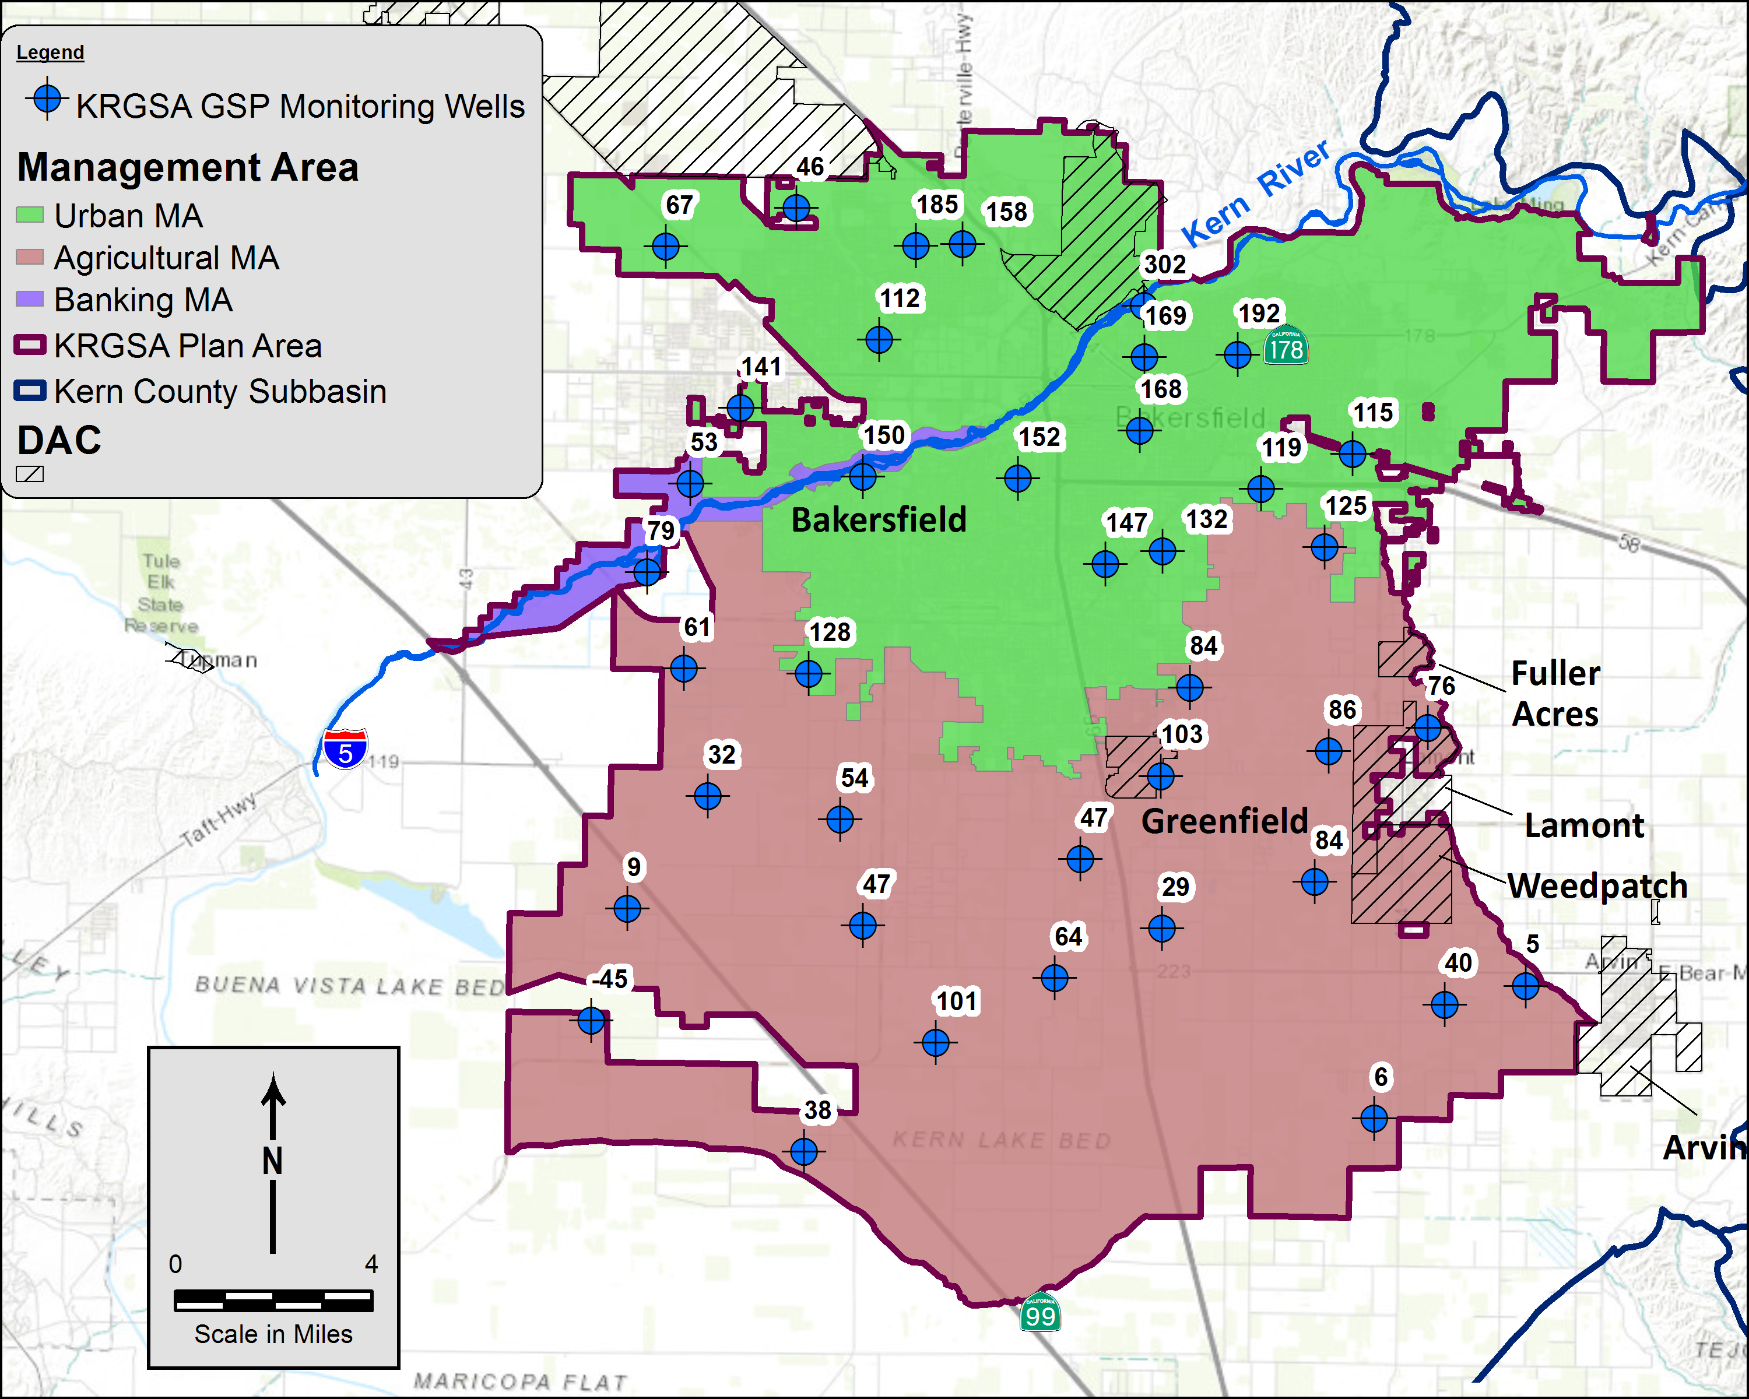
Adjustments to MTs: Input from Small Water Systems
Modified Minimum Thresholds (MTs) at request of Lamont and Fuller Acres
Consistent criteria with Urban MA
Modified MTs in 3 separate areas as requested by 4 separate Small Water Systems
DRAFT

Slide 24
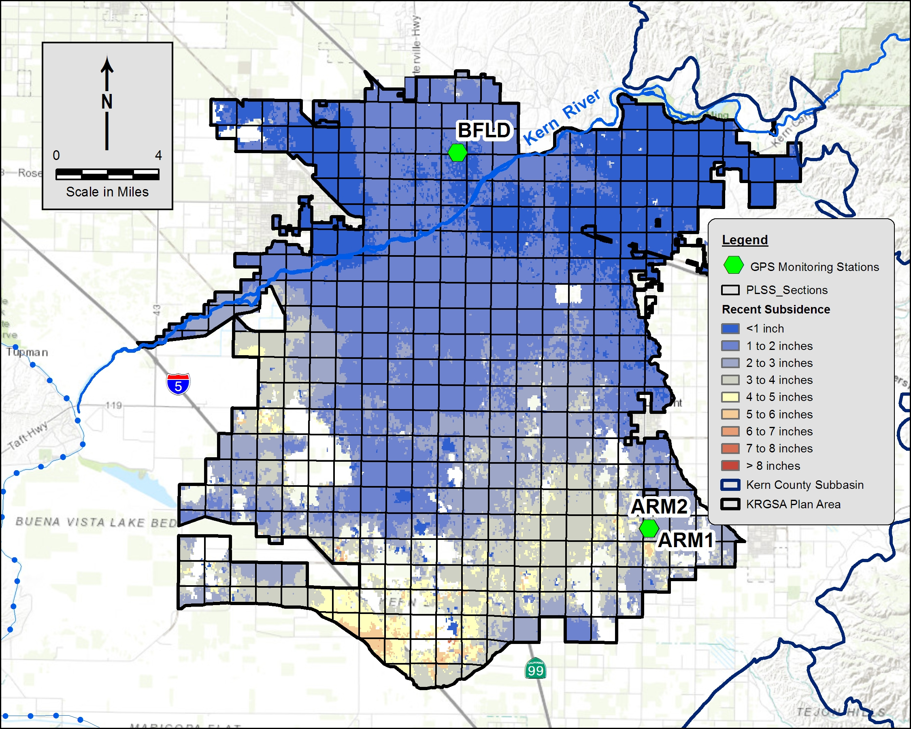
KRGSA Subsidence Monitoring
7th Standard Rd
Water level monitoring
Three GPS stations for screening
InSAR Subsidence available from DWR (on 1-mile grids)
Coordinate with KGA and other GSAs for regional Subbasin-wide subsidence monitoring
NASA/JPL May 2015 – Dec 2016
DRAFT

Slide 25
GSP Projects to Address Future Water Budget Deficits
Up to about 150,000 AFY of additional KRGSA supply
Project | Description | KRGSA Project Water
Water Allocation Plan | KDWD plans to use its full Kern River entitlement as prioritized in its Water Allocation Plan (WAP) for the Agricultural MA. The WAP total average supply has been corrected for planned sales to NKWSD. | 20,797 AFY
Kern River Optimized Conjunctive Use | The City plans to use its full Kern River entitlement, less current obligations, to mitigate undesirable results for water levels and water quality in the Urban MA. | 89,619 AFY
Expand Recycled Water Use in the KRGSA | The City will increase recycled water use inside of the KRGSA from its WWTP No. 3 in 2026 when a contract for use outside of the KRGSA expires (about 72% is currently used outside of the KRGSA). | 11,556 to 13,407 AFY
Conversion of Agricultural Lands to Urban Use | Approximately 10,000 acres of current KRGSA agricultural lands is expected to be urbanized; this future urban demand is already included in the projected water budget, so 100% of this agricultural water use represents a demand reduction. | 27,000 AFY
ENCSD North Weedpatch Highway Water System Consolidation | Up to six small water systems in the northeast KRGSA will be consolidated into the ENCSD system for benefits to drinking water quality, including to disadvantaged communities (DACs). | No new supply; improved water quality to DACs
Possible Water Exchange | KRGSA member agencies can perform exchanges of surface water and groundwater for benefits to water quality, including to DACs | No new supply; improved water quality to DACs
DRAFT

Slide 26
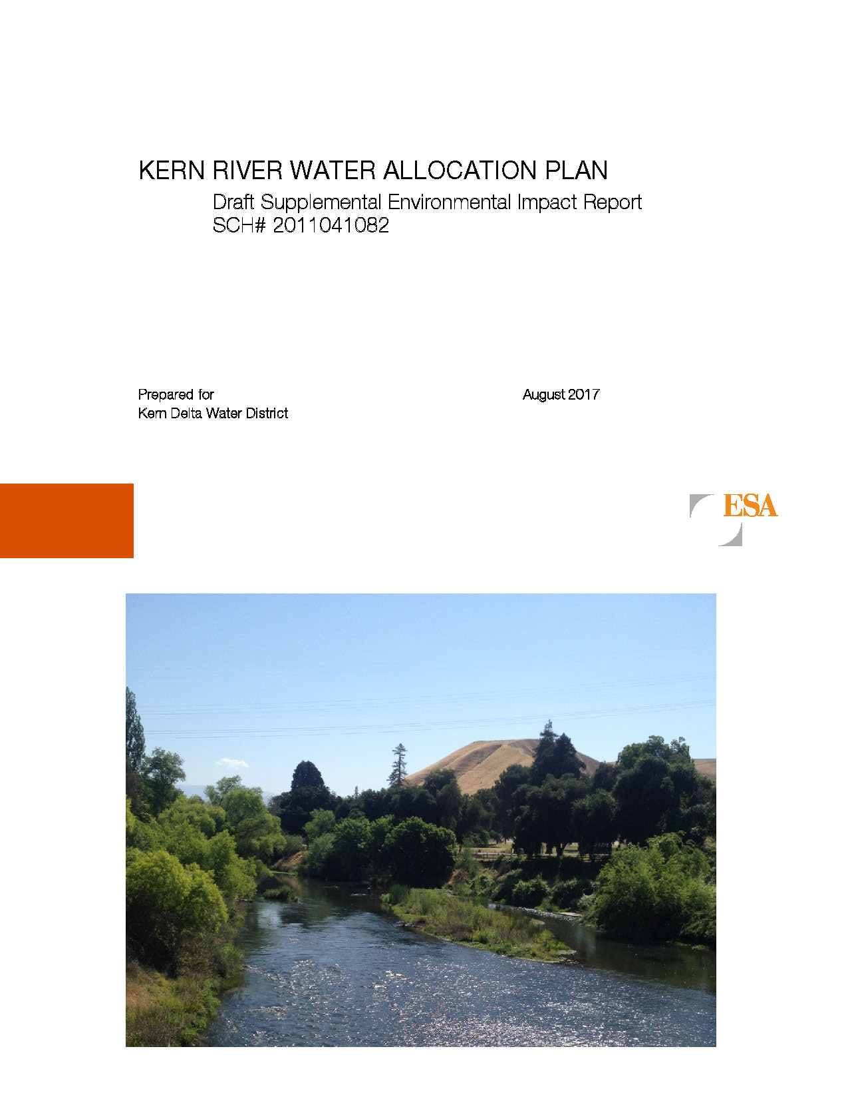
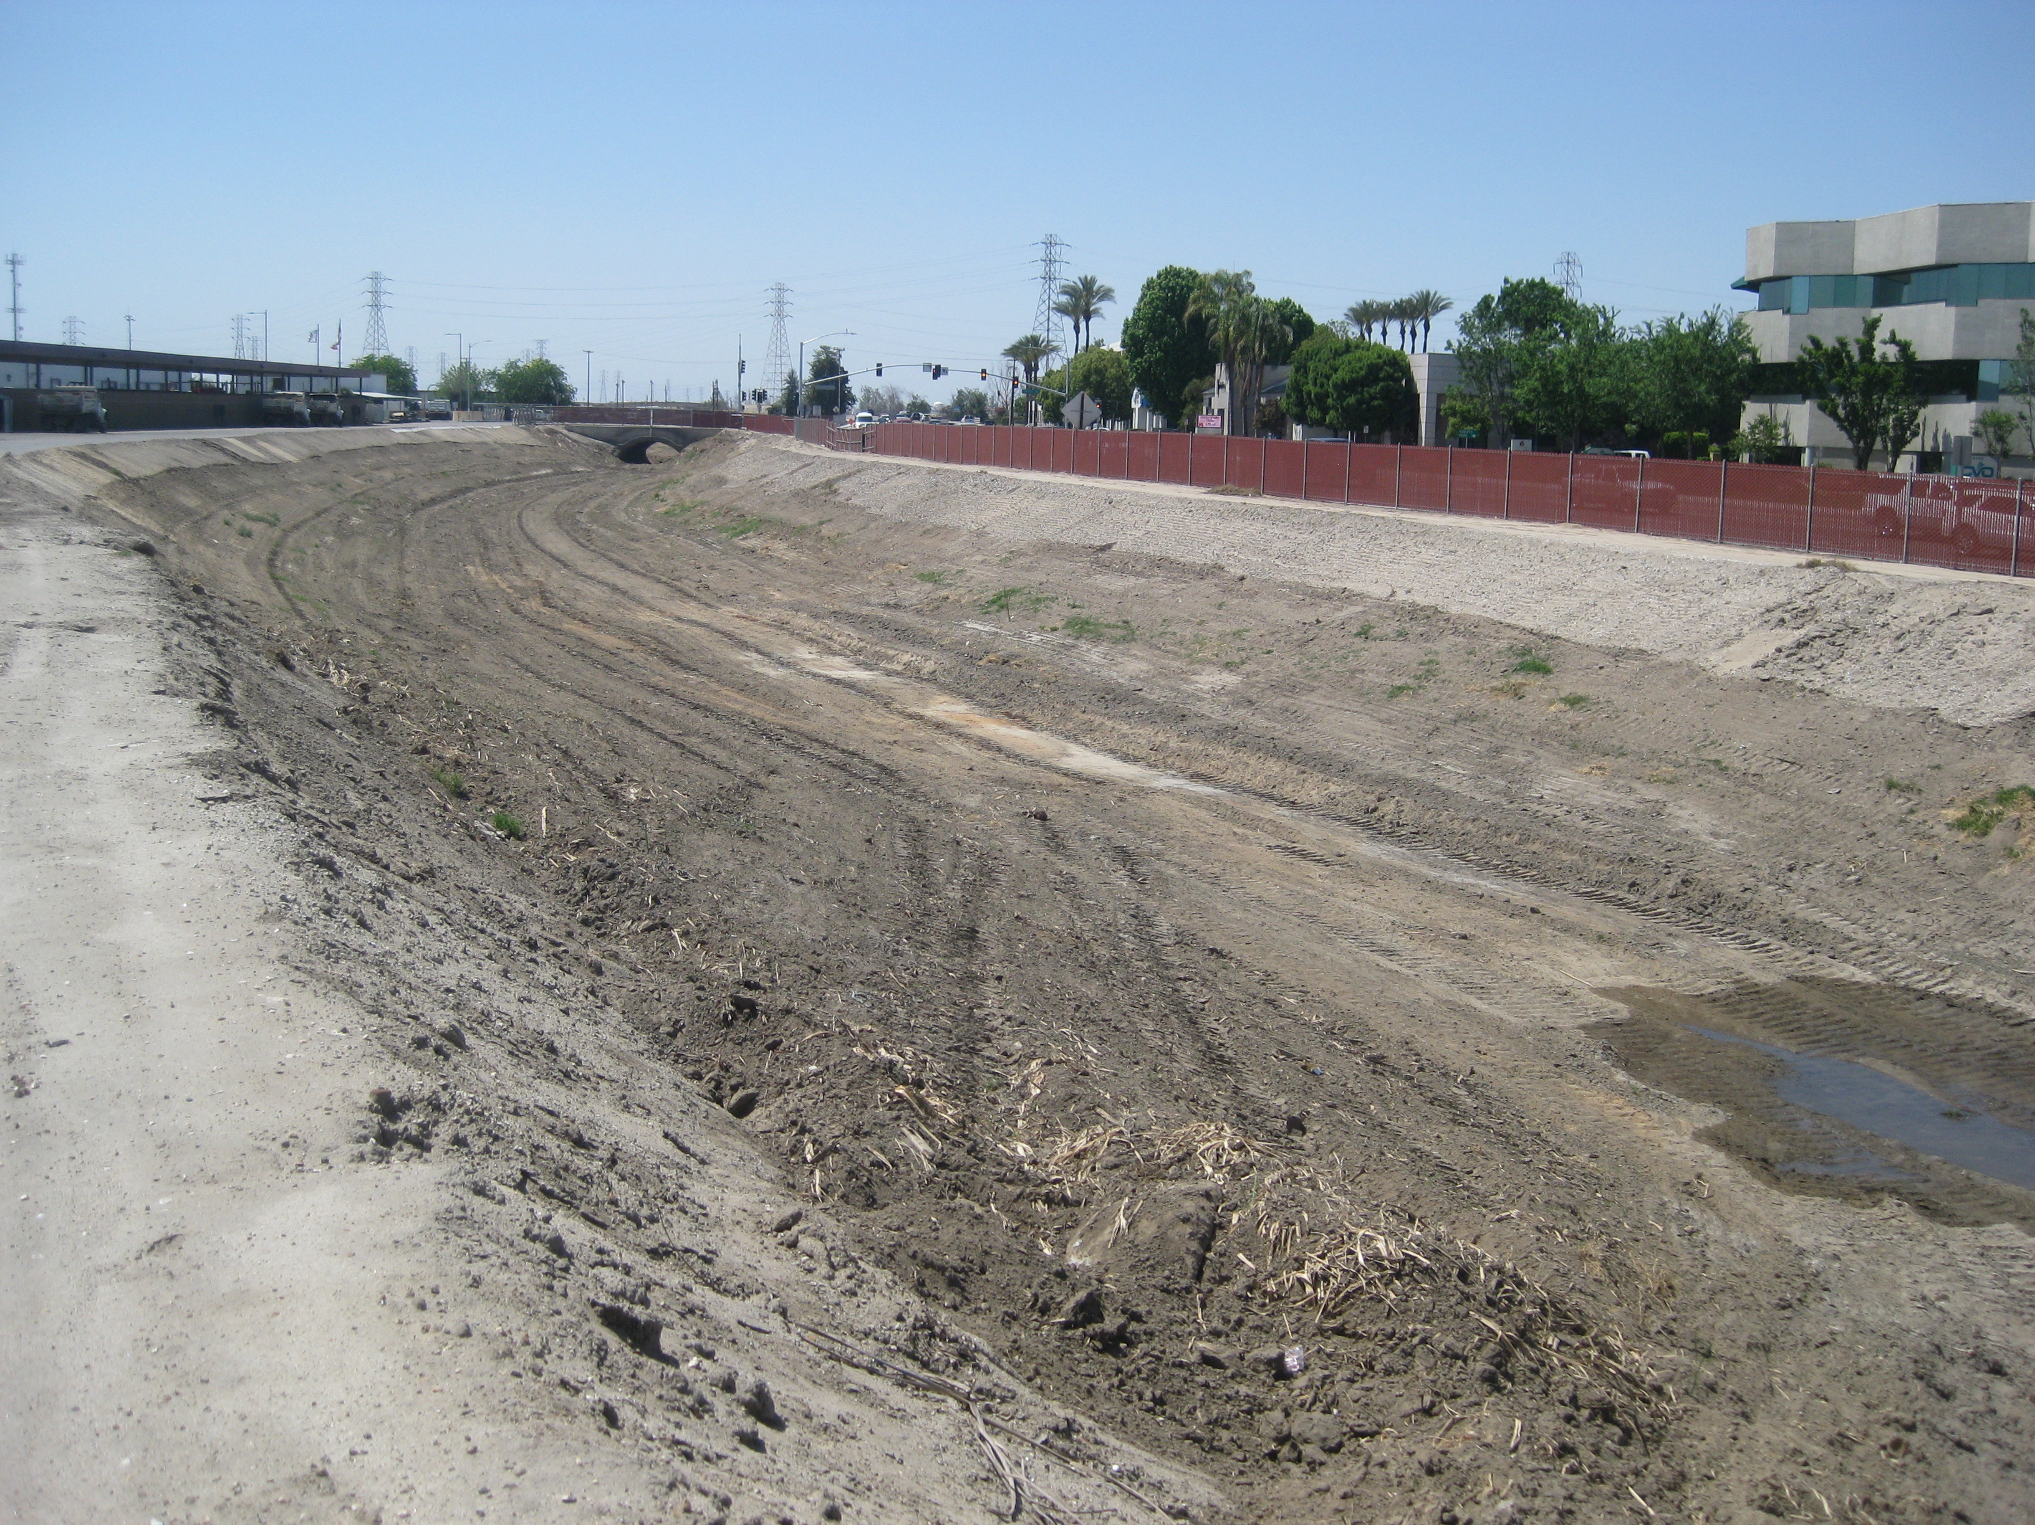
Key GSP Projects
KDWD Kern River Water Allocation Plan
  Optimizes Kern River recharge across the southern Plan Area
  Reduces groundwater pumping
  Allows local maintenance of water levels
  SEIR completed 2018 – implementation initiated
DRAFT

Slide 27
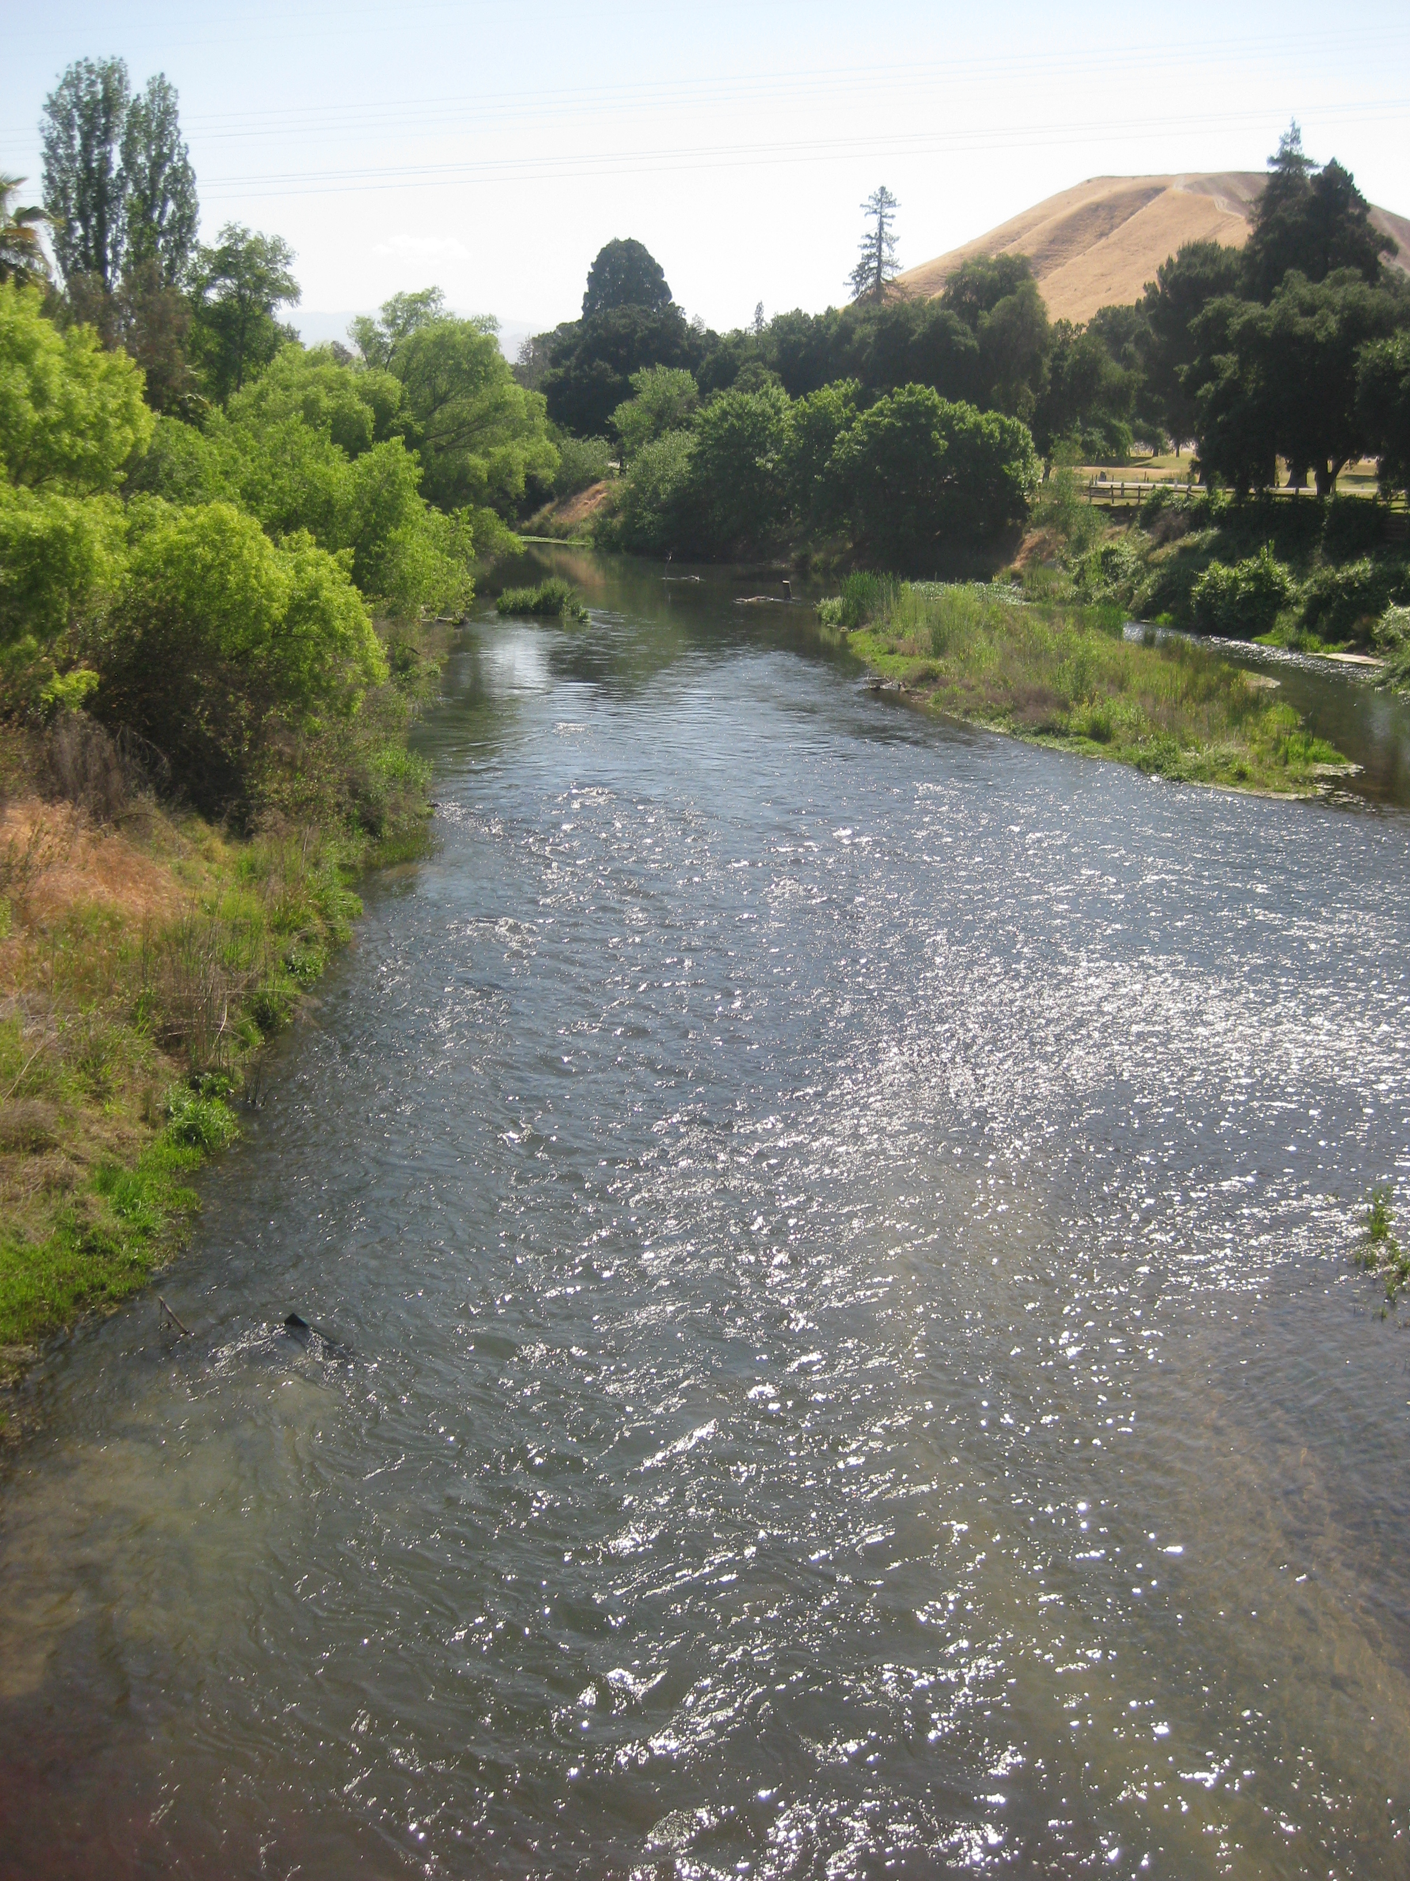
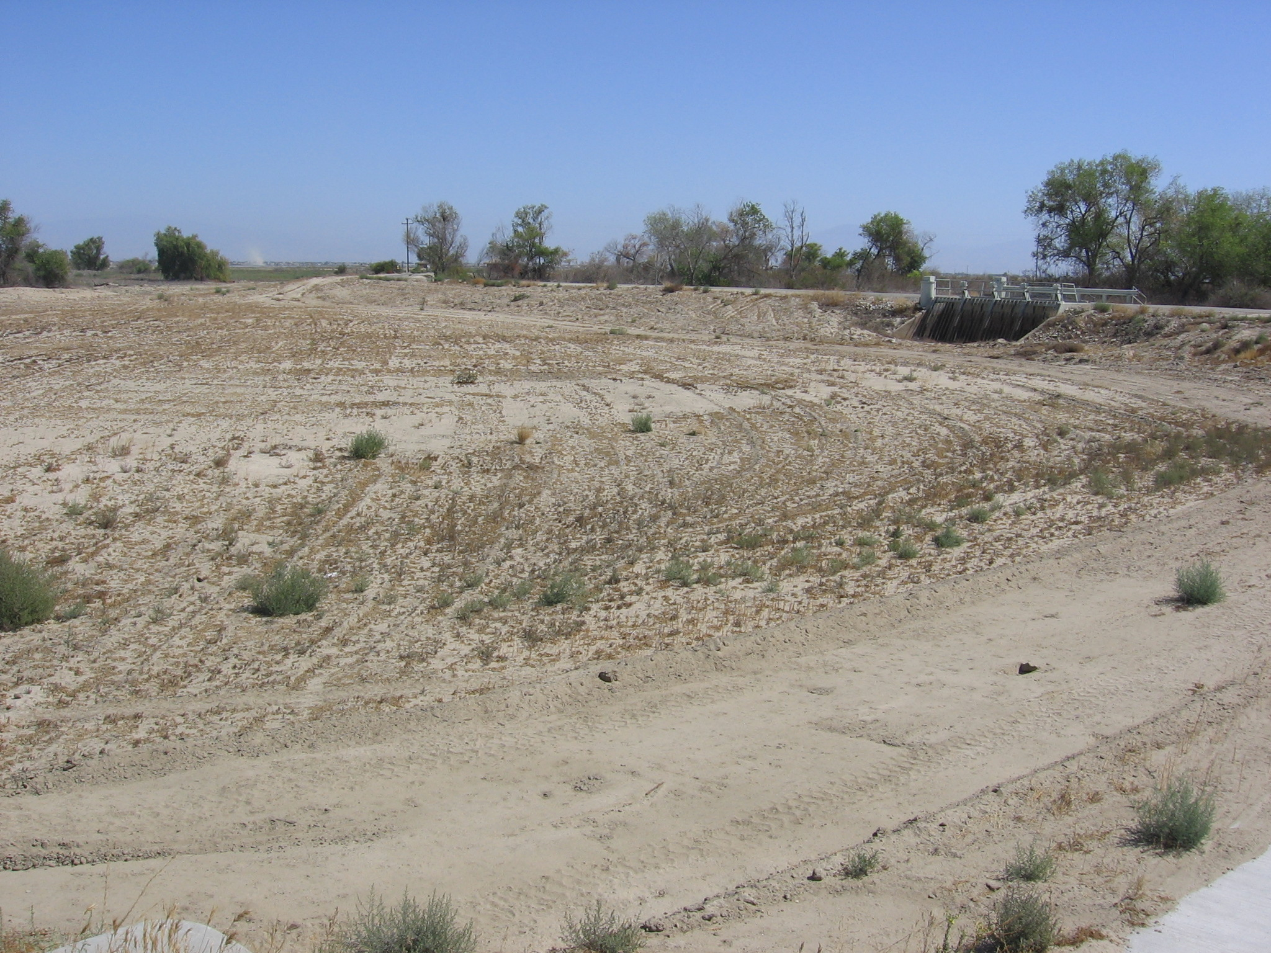
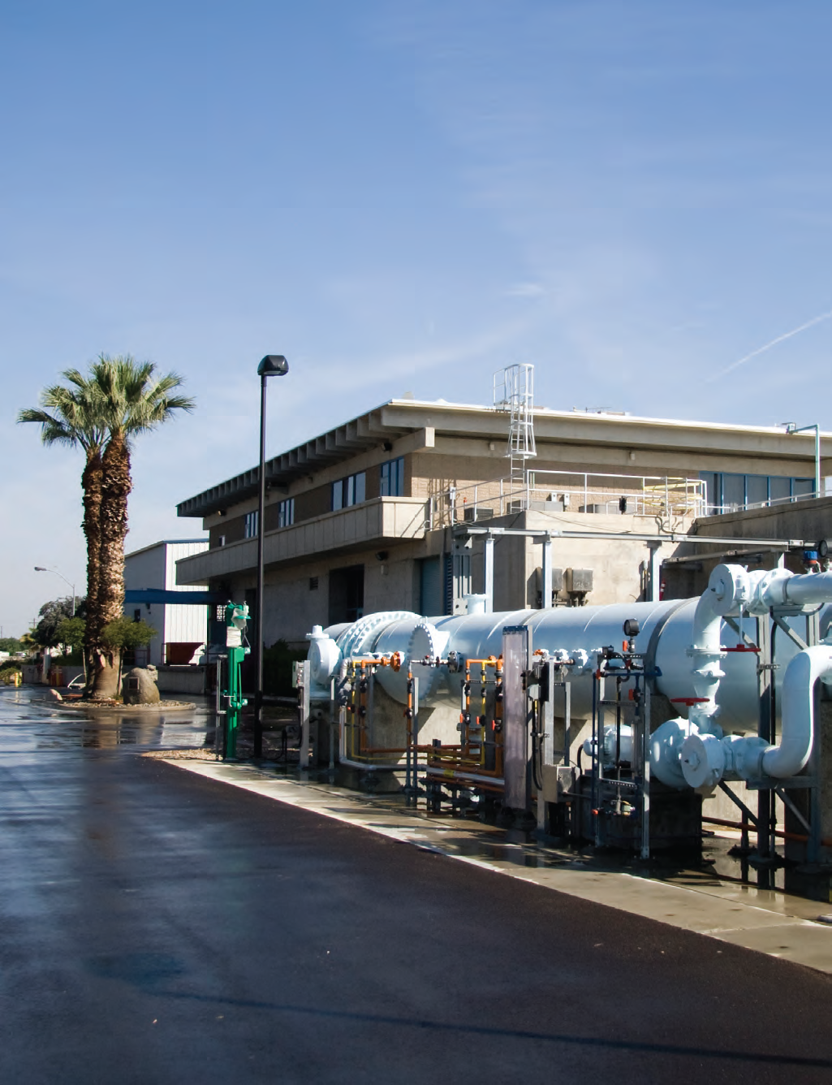
Key GSP Projects
City of Bakersfield Optimized Conjunctive Use
  Prioritizes use of City’s available Kern River water
  Increasing water availability over the implementation and planning horizon
  Allows municipal pumping to be reduced to avoid undesirable results
  Meets future projected water budget deficits for urban demand
DRAFT

Slide 28
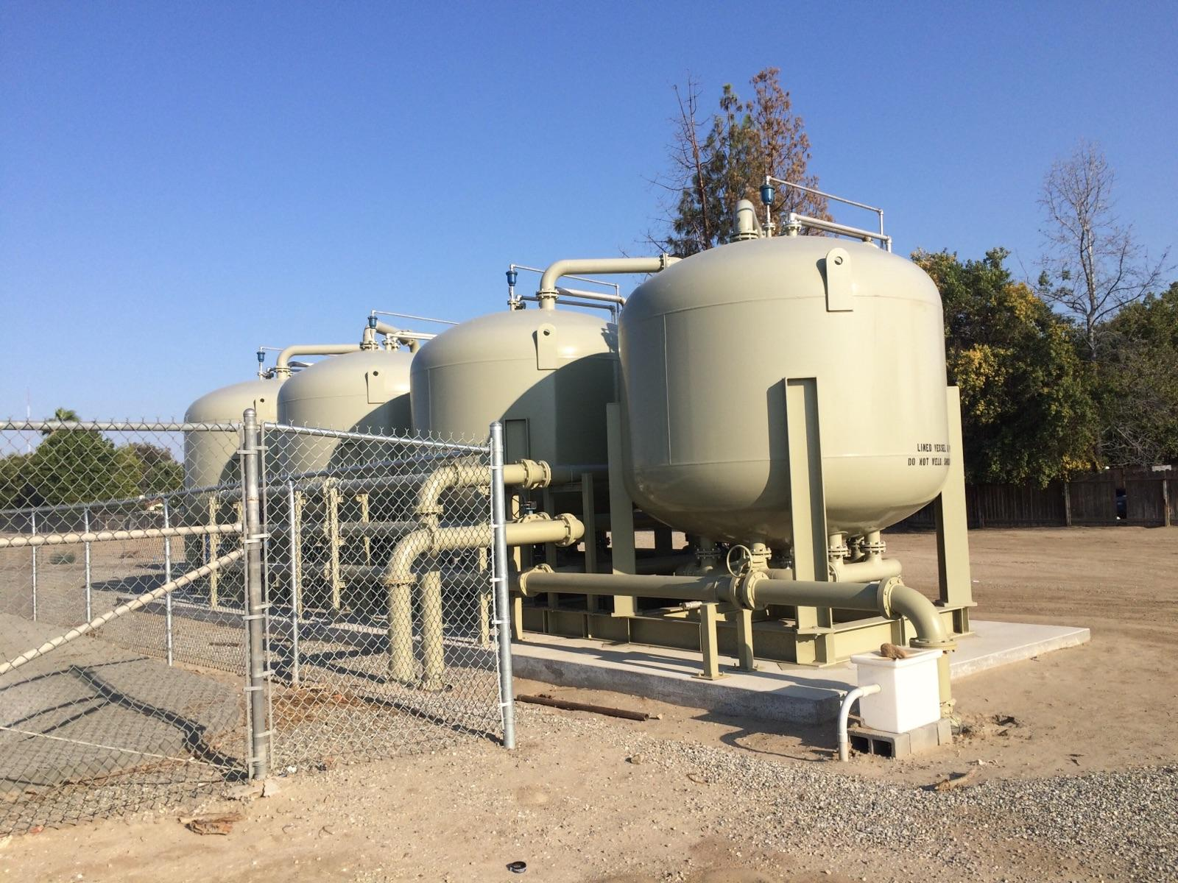
Key GSP Projects
East Niles Community Services District
North Weedpatch Highway Consolidation
Consolidation of up to six small water systems with ENCSD to address water quality concerns: nitrate, TCP, and arsenic
Grant funding through the DWRSF program
Improves drinking water quality for disadvantaged communities in the KRGSA
1,2,3-TCP Wellhead Treatment
DRAFT

Slide 29
Projected Water Budgets with GSP Projects
GSP projects and address current and projected water budget deficits to achieve sustainable management.
DRAFT

Slide 30
Management Actions – KRGSA Policies
5-Step Action Plan if Minimum Thresholds are exceeded
Optimize Conjunctive Use in the KRGSA
Implement a Well Metering Program
Implement a groundwater extractions Program
Support CA Delta Conveyance to Preserve Imported Supplies
Incorporate Climate Change Adaptation Strategies
Support Sustainable Groundwater Supplies for KRGSA DACs
Improve Groundwater Monitoring Program
Incorporate a Policy of Adaptive Management in the GSP Process
DRAFT

Slide 31
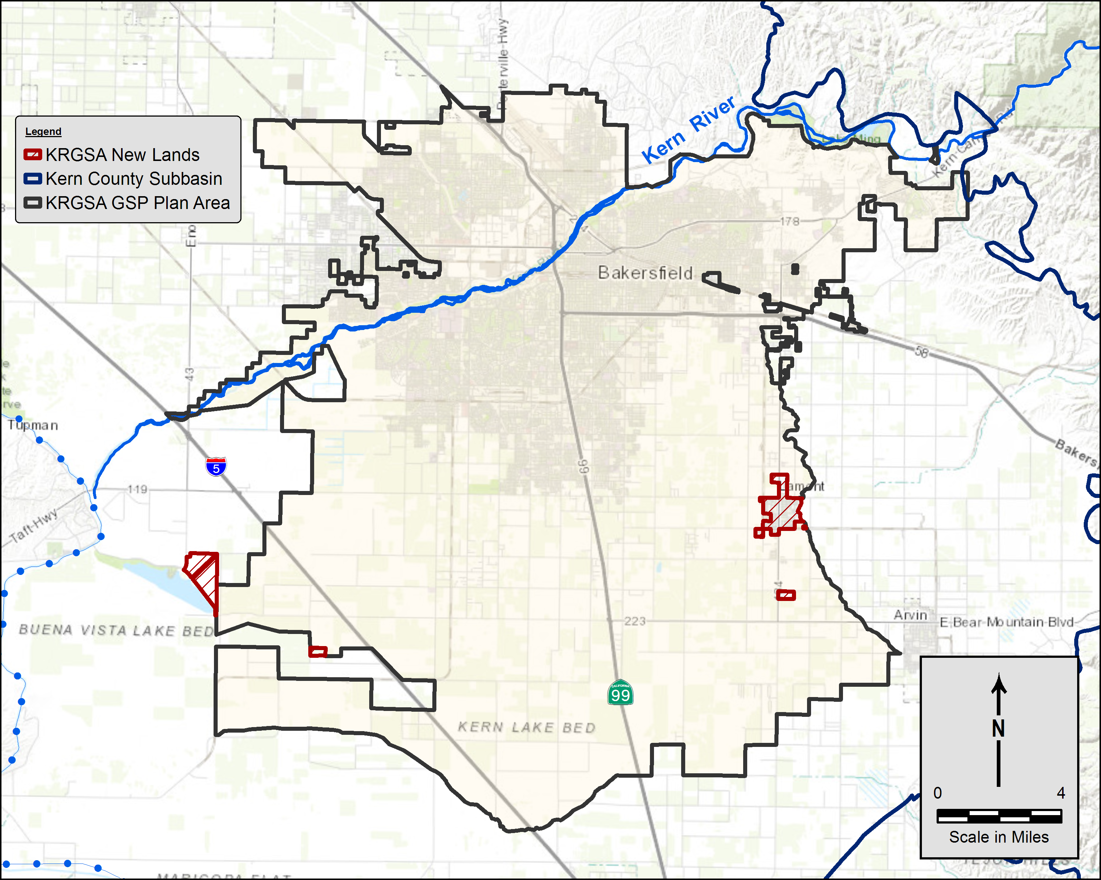
Additional Changes/Additions to Draft GSP
New Lands Added
Agricultural lands in southwest
Urban/Mixed land uses in southeast
Total 1,847 acres (less than 1% of previous Plan Area)
Eastern lands already in water budget; small water use in southwest (1,300 – 2,500 AFY)
New Appendix K of the GSP
Residential/ Mixed Use in east
Agricultural Lands in southwest
DRAFT

Slide 32
Public Comments on the Draft GSP
Chevron NA – meeting 2-14-19; email comments 8-5-19; 10-24-19
  Response: All comments discussed and incorporated
Leadership Counsel letter 7-10-19; letter 11-26-19
  Response: Letter from KRGSA 8-13-19
  Response: Reviewed comments; clarifications to GSP, as applicable
California Department of Fish and Wildlife
  Response: Reviewed comments; clarifications to GSP, as applicable
City of Los Angeles
  Response: Revised recycled water amounts on Table 2-1 (revised to 11,321 AFY)
  Response: Modified discharge provided from February through September
  Response: Provide notifications regarding any future GSA actions
DRAFT
Notes:
In the presentation, I’ll dismiss Chevron comments (already completed) and the City of LA comments. I worked with Art to get the correct edits in the document, emailed them to him and he is making sure that Ginny and others say ok. Then I’ll proceed with comments from Leadership Counsel and the CDFW.

Slide 33
Public Comments
Leadership Counsel for Justice & Accountability
23-page letter of perceived deficiencies/un-met requirements
Numerous Comments Claim non-engagement of Small Water Systems and DACs
  Response: 1st meeting with Small Water Suppliers July 2017; numerous outreach meetings and 2 Open Houses; ongoing relationships between GSA members and Small Water Systems; GSP projects and management actions target DACS; Adjusted MTs based on Small Systems input; many other activities
  Response: Lamont PUD joined the KRGSA after the Draft GSP was prepared; edits and adjusted MTs based on their input; may add Lamont PUD MW to GSP program
Attached technical analysis on 3 issues (responses on following slides):
  Water Budget Checkbook and Future Water Budget Hydrology
  Water Quality
  Dry Well Analysis
DRAFT
Notes:
This is the one slide that I’m still working on. The remaining slides discuss the three bullet items in the technical analysis above.

Slide 34
Response to Public Comments – Water Budget
Leadership Counsel for Justice & Accountability
Comment: Checkbook doesn’t account for subsurface outflows that could impact recharged water
Response: Model analysis does account for subsurface outflows
  Recharge used to maintain water levels; seasonal recovery with local wells (not all water is banked long-term)
  Conditions are dynamic and will change over time
  Water budget components and MTs/MOs monitored
Comment: Projected Water Budget hydrology not variable
Response: Contains both the wettest year and driest year in the 50-year period and period of largest water level fluctuations in most areas
  Compares to rainfall and streamflow over a 50-year period
  Explained in detail in the model documentation (Attachment 1)
DRAFT

Slide 35
Response to Public Comments – Water Quality
Leadership Counsel for Justice & Accountability
Comment: TDS, nitrates and arsenic are actively managed and programs are described adequately (no response required)
Comment: Includes suggestions for Annual Report (noted)
Comment: Pesticides not detected above MCLs (no response required)
Comment: Suggest clarifying language on local management (considered)
Comment: Questions on sources and impacts to wells (response – management actions and monitoring program will address these issues)
Comment: Provide additional information on 1,2,3-TCP (response – noted in GSP that the KRGSA will be analyzing TCP water quality data)
DRAFT

Slide 36
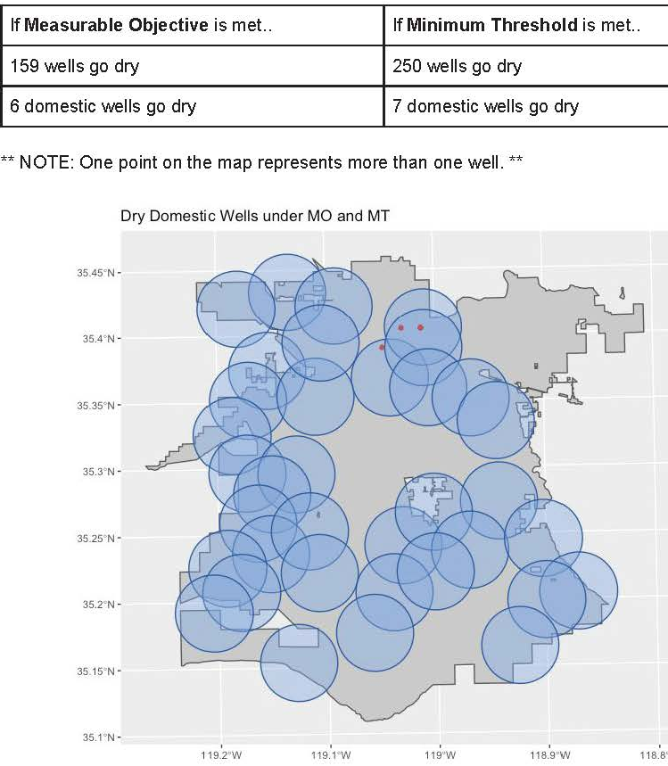
Public Comments –
Dry Well Analysis
Leadership Counsel
Larger no. of wells include monitoring, remediation, cathodic, test wells, etc.
Provided a “Dry Well Analysis” of the Minimum Thresholds (MTs) and Measurable Objectives (MOs)
Places a 2-mile blue-bubble radius around the monitoring wells
Count number of wells going “dry” for each MO or MT bubble
Out of 3,633 wells, predict six or seven domestic wells will go dry
6 to 7 Domestic Wells
Blue Bubbles are GSP Monitoring Wells
DRAFT

Slide 37
Response to Public Comments –
Dry Well Analysis
Leadership Counsel
Larger no. of wells include monitoring, remediation, cathodic, test wells, etc.
All “dry wells” are in Urban MA where higher water levels are maintained
MO is average water level; if 159 wells go dry every time water levels are “average” or below, they have been dry for a long period of time (i.e., 1990s)
MT is historic low level – well would have been dry before any GSP action was taken
Located in City/Cal Water/OMWC service areas; pumping reported to ID4
6 to 7 Domestic Wells
Blue Bubbles are GSP Monitoring Wells
DRAFT
Notes:
Finally, KDWD staff spent months in the service area mapping out all equipped active wells. ID4 monitors all pumping in the ID4 area. Those are presented in the KRGSA GSP and are much more accurate than the old, inactive, and typically mis-located wells in the DWR Well completion Report files.

Slide 38
Public Comments and Responses
California Department of Fish and Wildlife
No wells occur on certain CDFW lands in the Plan Area
  Response: Other nearby wells inform local groundwater conditions
Identify habitats and species that may depend on groundwater and identify monitoring to track environmental beneficial uses over time.
  Response: NCCAG maps (TNC/DWR) and species included in GSP Section 3.3.6
Analysis merits further investigation and recommends installation of shallow monitoring wells. Also recommends additional analysis.
  Response: Shallow GSP monitoring well at Calloway Pool; additional future analysis to be considered if conditions change
No consideration of environmental uses of groundwater in management criteria.
  Response: No interconnected surface water indicated; no environmental uses of groundwater identified; sustainability goal to protect any future identified environmental beneficial uses of groundwater
DRAFT
Notes:
Response: Agree, but numerous wells in the northern Plan Area provide information on groundwater conditions in the area.
Response: The analysis of interconnected surface water and GDE identification is included in the GSP (Section 3.3.6). No interconnected surface water or GDEs were identified. Shallow GSP monitoring at the area with the most healthy ecosystem on the river will continue. All Projects and Management Actions protect any missed interconnected surface water or GDEs in the Plan Area.
Response: Possible future consideration if indications of interconnected surface water in the future. Monitoring perched water is not recommended.
Response: No current environmental uses of groundwater identified so not required.
1. Not related. Over-draft mitigated through our detailed water budget.
2. Yes it is (Figure 3-34) – maybe include

Slide 39
Additional Public Comments
California Department of Fish and Wildlife
No consideration of environmental uses of groundwater in management criteria.
  Response: No interconnected surface water indicated; no environmental uses of groundwater identified; sustainability goal to protect any future identified environmental beneficial uses of groundwater
Critically over-drafted basin should not allow MTs to lower water levels.
Response: GSP brings KRGSA water budget into balance
Groundwater elevations as a proxy for water quality is not supported by correlations between concentrations and elevation.
Response: Yes it is; see Figure 3-14 Section 3.3.4.6
Anticipates involvement in CEQA for GSP projects (no response required)
DRAFT
Notes:
Response: Agree, but numerous wells in the northern Plan Area provide information on groundwater conditions in the area.
Response: The analysis of interconnected surface water and GDE identification is included in the GSP (Section 3.3.6). No interconnected surface water or GDEs were identified. Shallow GSP monitoring at the area with the most healthy ecosystem on the river will continue. All Projects and Management Actions protect any missed interconnected surface water or GDEs in the Plan Area.
Response: Possible future consideration if indications of interconnected surface water in the future. Monitoring perched water is not recommended.
Response: No current environmental uses of groundwater identified so not required.
1. Not related. Over-draft mitigated through our detailed water budget.
2. Yes it is (Figure 3-34) – maybe include

Slide 40
Next Steps
Board Adoption of Final GSP 12-05-2019
Additional minor revisions/cleanup of Draft GSP, as directed by the Board including clarifications in response to public comments, as needed
Final document and data preparation
Submit to DWR by January 31, 2020
DRAFT
Notes:
Board approved Draft 8-21-2019; Published on website 8-29-2019

Slide 41
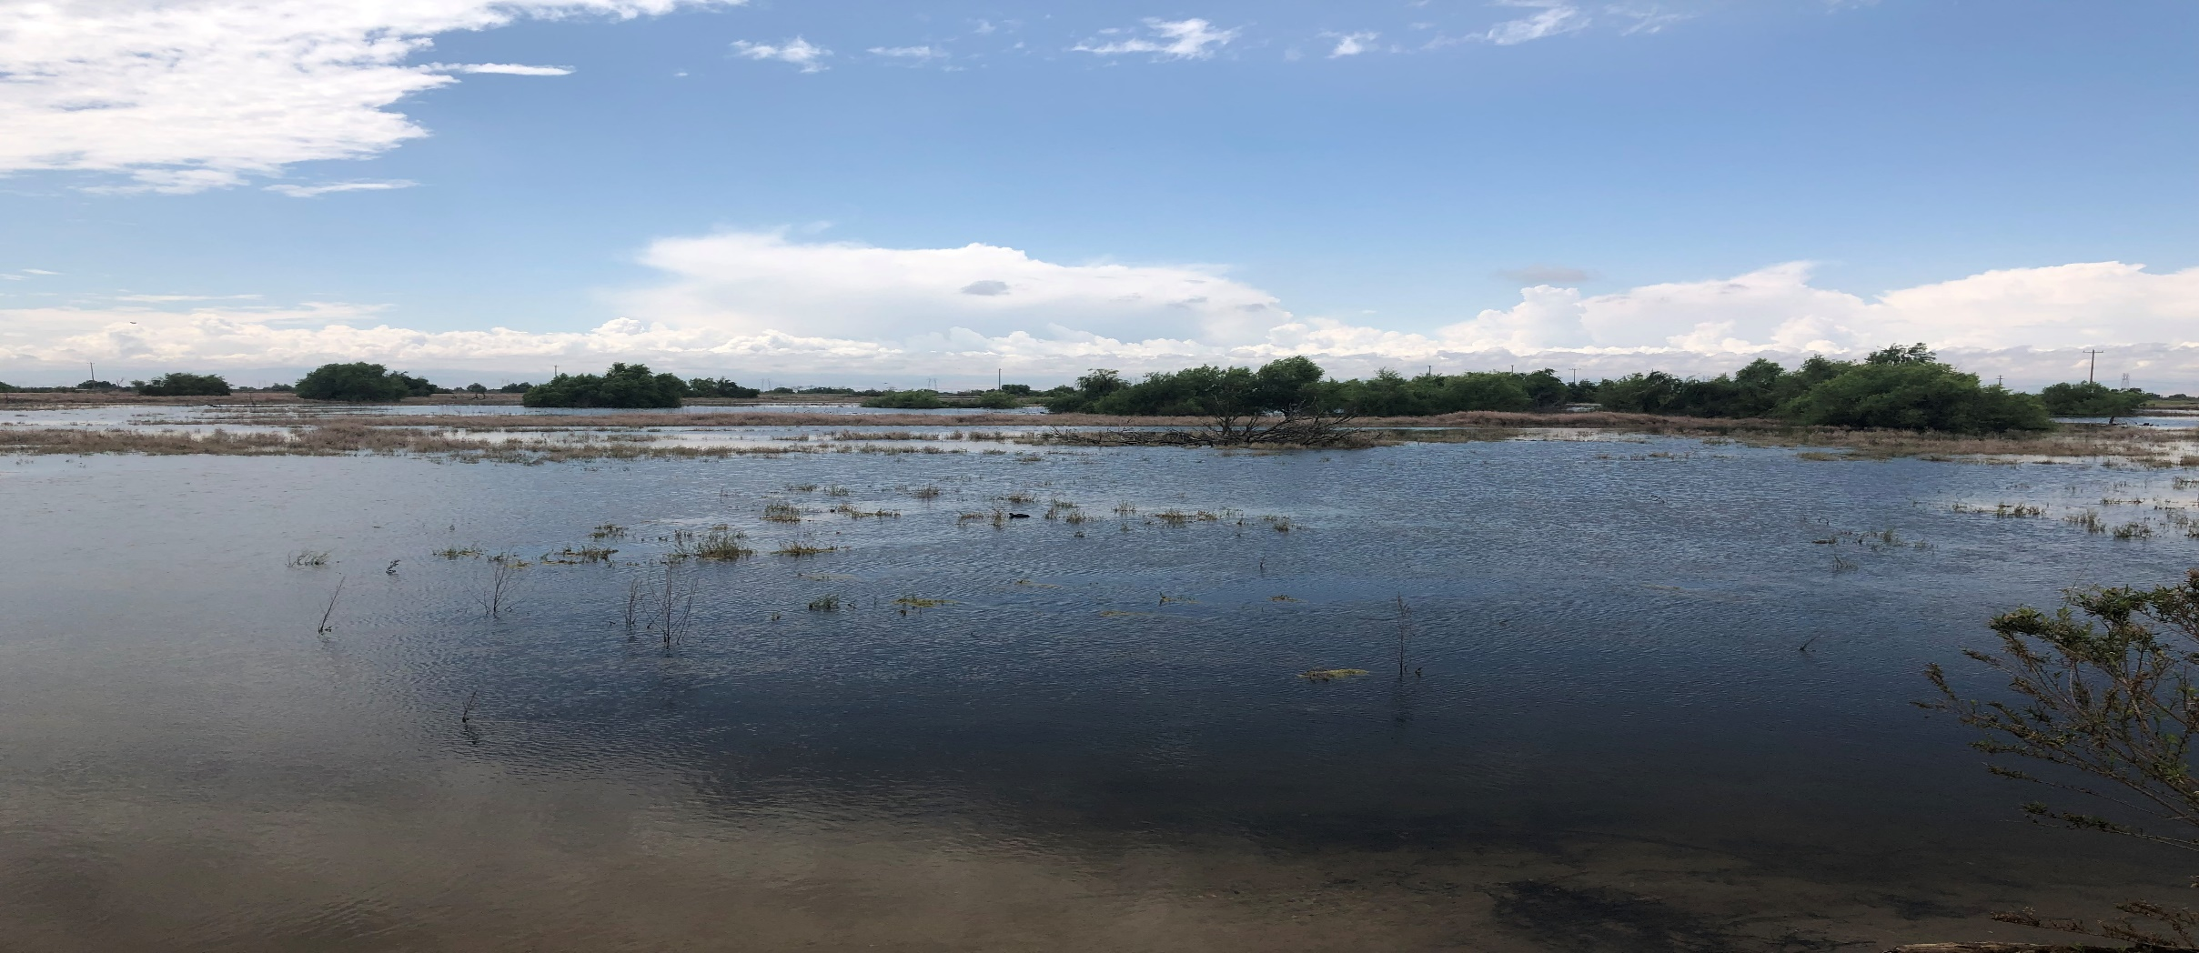
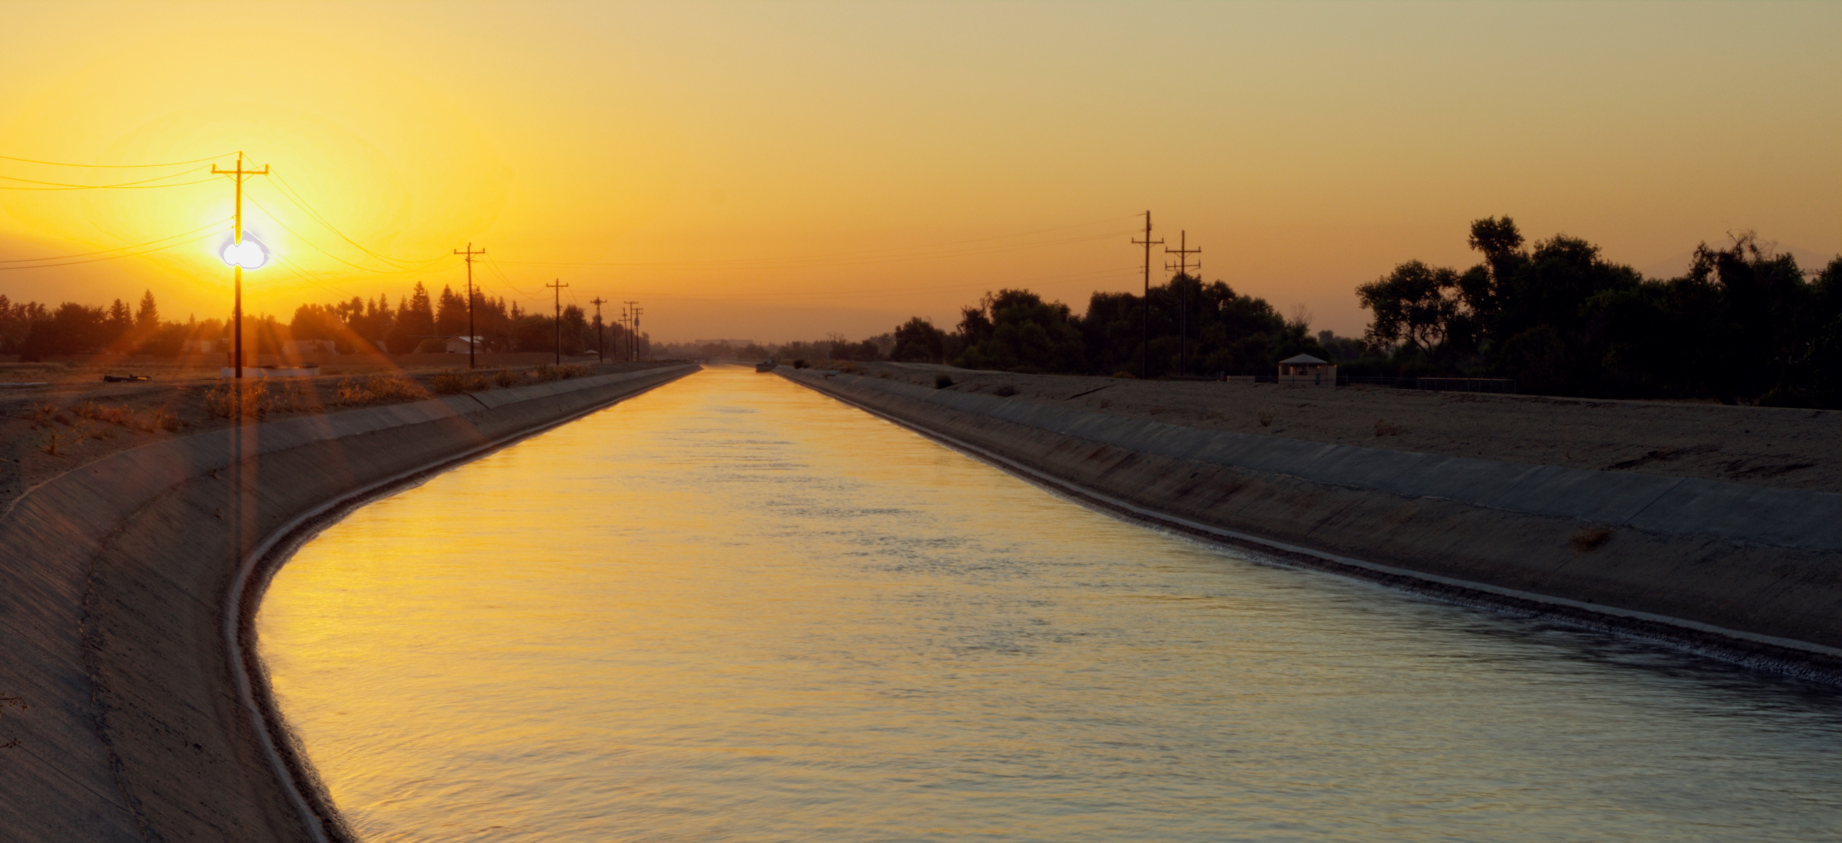
Questions?

